Slide 1
FUNDAMENTALS 201: DEVELOPMENT PROCESS, LAND USE, AND PLANNING
Notes:
Hello and welcome to the fundamentals of the Development Process related to Land Use and Planning. My name is J.J. Folsom and I am a director with Community Builders, a non profit organization that works with communities throughout Colorado and the intermountain west.
The Division of Housing partners with local communities to create housing opportunities for Coloradans who face the greatest challenges to accessing affordable, safe, and secure homes. DOH supports projects ranging from homelessness prevention to homeownership. The Local Officials Toolkit, a joint project between DOH, Enterprise Community Partners, and Community Builders is intended to help local communities identify possible housing opportunities and streamline their processes to achieve housing faster. The toolkit will explain affordable housing in the context of Colorado. Separated into three parts, the Toolkit includes Affordable Housing 101, this training- 201 fundamental modules that can be found online and a set of potential tools & solutions such as policies, programs, and partnerships, to name a few, that communities can use and are already using to address housing needs in Colorado. A menu of options that would in most cases make up the bulk of the content for the in-person trainings.
Enterprise Community Partners is a national nonprofit that brings together nationwide expertise, partners, policy leadership and investment to multiply the impact of local affordable housing development. They deliver the capital, develop the programs, and advocate for the policies needed to create and preserve well-designed homes that people can afford in inclusive and connected communities.
Community Builders is a leader in community planning, design and development with core competencies in training and capacity building, direct technical assistance, and public engagement and facilitation. In applying these skills, we bring a range of expertise in community planning and development, including housing, transportation, economic development, urban design, and downtown revitalization.

Slide 2
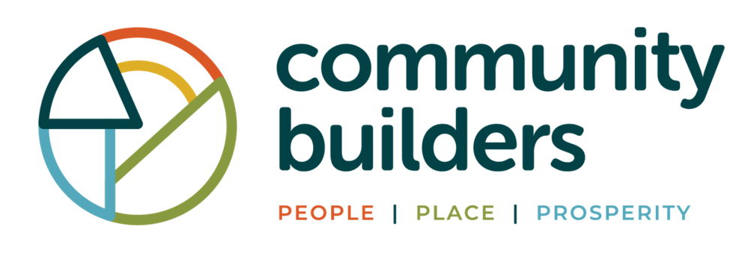


GOAL OF THE TRAINING
  The purpose of this training is to introduce the development process, key participants throughout development, important development types, and how you, as Local Elected Officials, can support development of affordable housing in your communities.
Notes:
The purpose of this training is to introduce the development process, key participants throughout development, important development types, and how you, as Local Elected Officials, can support development of affordable housing in your communities.

Slide 3
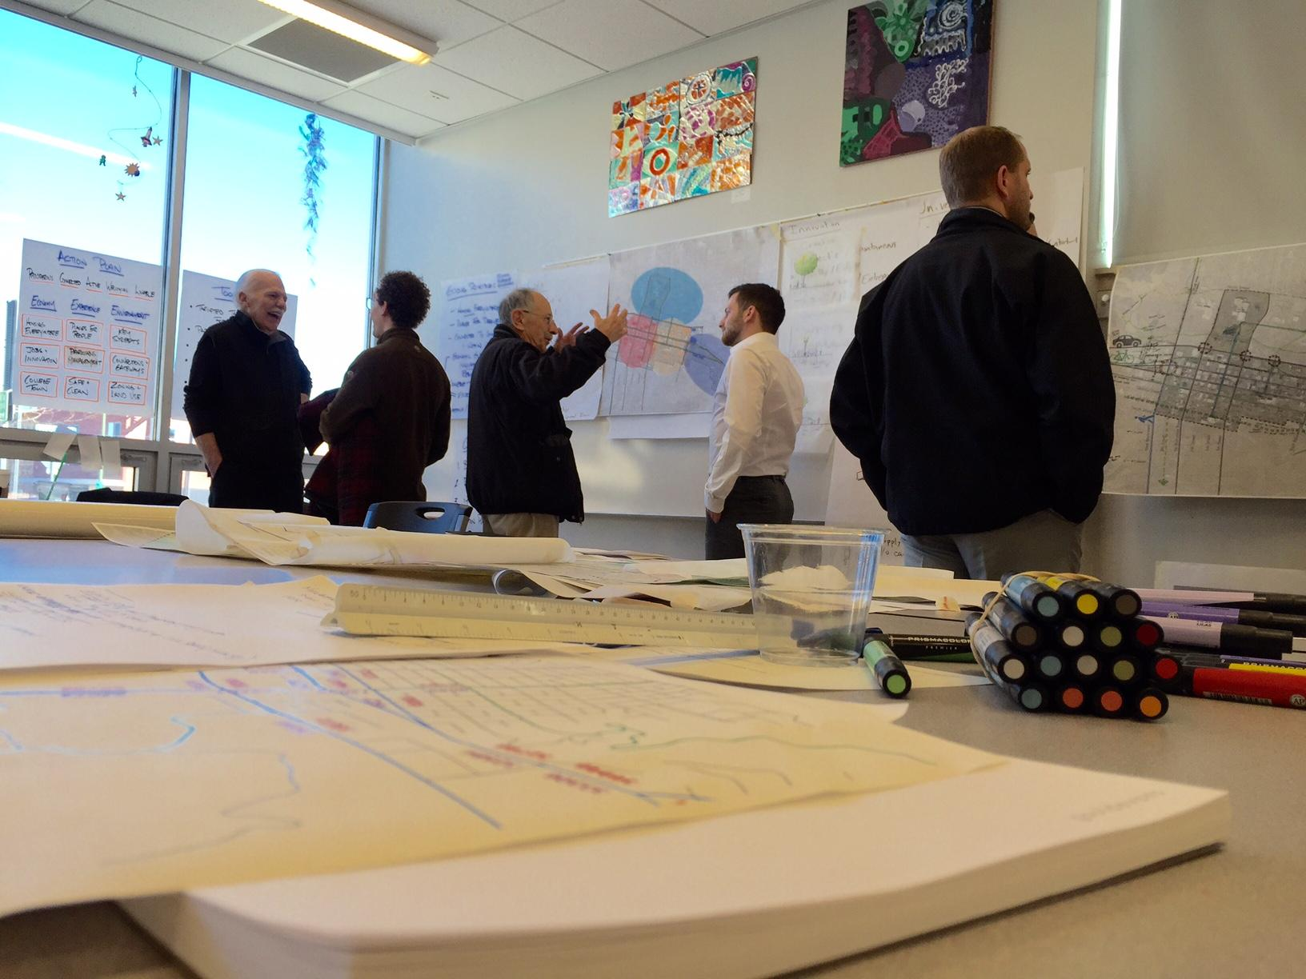

The Development Process
Notes:
First, I will give a brief overview of the development process

Slide 4
PHASES OF DEVELOPMENT & LOCAL OFFICIALS ROLE
Phase I:
Visioning
Phase 2: Planning & Predevelopment
Phase 3:
Securing Funding
Phase 4:
Design
Phase 5:
Construction
Phase 6:
Operations
Notes:
Whether building market rate or affordable housing, the development process generally has the same six steps illustrated on this slide. The development process and timeframe can be unpredictable depending on the complexity of the project, and like any project, unexpected hurdles can occur at any time. For example, issues with a financing source could occur, development review can be stalled for a variety of reasons, labor and material shortages can continue to get worse, and the list goes on.

Slide 5
TYPICAL DEVELOPMENT TIMELINE GRAPHIC
Phase 1: Visioning
(12 months or more)
Phase 2: Planning & Predevelopment
(12-36 months, including Securing Funding & Design)
Phase 5: Construction
(12-24 months)
Phase 6: Operation
(Ongoing)
Phase 3: Securing Funding
Phase 4: Design
Process
Start
1 Year
2 Years
3 Years
4 Years
Notes:
This timeline illustrates a representation of a typical development process. It is critical to emphasize the length and importance of the predevelopment phase, which can take up to 3 years before any construction occurs. This is often described by developers as the “risk” they take for many projects.

Slide 6
PHASE 1 - VISIONING
The visioning phase focuses on understanding:
your community’s need for affordable housing;
  housing types to respond to that need;
  your jurisdictions’ capacity for the participation that will be required to develop this type of housing; and,
  what additional partnerships may be necessary to fill your capacity gaps.
  Timeline:
Phase 1: Visioning
Phase 2: Planning & Predevelopment
Phase 5: Construction
Phase 6: Operation
Phase 3: Securing Funding
Phase 4: Design
Notes:
Phase 1 Visioning focuses on understanding your community’s need for affordable housing; housing types to respond to that need; your jurisdictions’ capacity for the participation, and additional partnerships that may be necessary to fill your capacity gaps.

Slide 7
PHASE 2: PLANNING AND PREDEVELOPMENT
This planning and predevelopment phase takes your concept into a specific development scope of work, including:
locating and/or purchasing a development site;
working with a design team to prepare a design concept; and,
preparing feasibility assessments and cost estimates.
Timeline:
Predevelopment alone can take more than a year or even multiple years, particularly for affordable development that uses tax credits or complex financing.
Phase 1: Visioning
Phase 2: Planning & Predevelopment
Phase 5: Construction
Phase 6: Operation
Phase 3: Securing Funding
Phase 4: Design
Notes:
Phase 2 – Planning and predevelopment takes your vision into a specific development scope of work, including locating and/or purchasing a development site; working with a design team to prepare a design concept; and preparing feasibility assessments and cost estimates.
It is important to note that we discuss more about key development feasibility factors in the Housing Finance Training that can be found in the link where you found this presentation.
In some cases these are challenges for development to HAPPEN AT ALL and in others it may be viable to develop units, but just not at the price points to address key housing needs IN in your community

Slide 8
PHASE 3: SECURING FUNDING
The funding phase includes obtaining the financing required to design, construct, and operate the development for the duration of the project, including:
determining and securing multiple financing sources; and,
completing multiple applications for the various funders.
Timeline:
Phase 1: Visioning
Phase 2: Planning & Predevelopment
Phase 5: Construction
Phase 6: Operation
Phase 3: Securing Funding
Phase 4: Design
Notes:
Phase 3 Securing funding includes obtaining the financing required to design, construct, and operate the development for the duration of the project, including determining and securing multiple financing sources and completing multiple applications for the various funders.

Slide 9
PHASE 4: DESIGN
The design phase includes the final contracting with the various design experts needed (described on later slides).
PHASE 5: CONSTRUCTION
The construction phase includes the preparation of the development site for construction and the actual construction or rehabilitation.
Timeline:
Phase 1: Visioning
Phase 2: Planning & Predevelopment
Phase 5: Construction
Phase 6: Operation
Phase 3: Securing Funding
Phase 4: Design
Notes:
The Design Phase includes the final contracting with a variety of design experts that I will describe later.
The Construction Phase includes the preparation of the development site and the actual construction or rehabilitation.

Slide 10
PHASE 6: OPERATIONS
The operations phase includes:
obtaining tenants and signing leases if the development is a rental project or selling units if the development is a for-sale project;
identifying service providers and preparing agreements;
managing the property or securing a property manager; and,
long-term stewardship/management of the development.
Timeline:
Phase 1: Visioning
Phase 2: Planning & Predevelopment
Phase 5: Construction
Phase 6: Operation
Phase 3: Securing Funding
Phase 4: Design
Notes:
The operations and final phase includes obtaining tenants and signing leases or selling units, identifying service providers and preparing agreements, managing the property or securing a property manager; and long-term stewardship/management of the development.

Slide 11
WHO IS INVOLVED?
Key Project Team Members
Private
Public
Consultants & Contractors
Developer/Developer Partner
Landowner/Leaseholder
Property manager
Service Provider
Town/City planning & zoning
Development review
Planning Commission
City Council/Trustees
Public Utilities
Inspectors
General contractor
Architects, Engineers, Surveyor
Environmental analyst
Market or real-estate analyst
Attorneys
Housing finance adviser
Notes:
Local government involvement is often needed to initiate the affordable housing development. Given the complexity of developing affordable housing and the inherent risk involved in real estate, each successful project requires extensive collaboration and coordination from an experienced team of professionals. Active local government participation can lower the risk, reduce costs by streamlining some of the processes, and help to develop the best product to meet local needs. Rarely does a single entity have the resources and capacity to develop affordable housing independently. Consequently, partnerships bring together the expertise and resources needed to complete the housing development process and may enable a local government to work on solving different aspects of the local housing picture, without pushing any one agency beyond capacity or duplicating services. When deciding on a course of action to address community housing needs, local governments must first determine their internal capacity, deficiencies, and gaps in order to assess what partnerships and consultant assistance may be required. This graphic illustrates the variety of private, public, and consultants that are typically needed for a successful project.

Slide 12
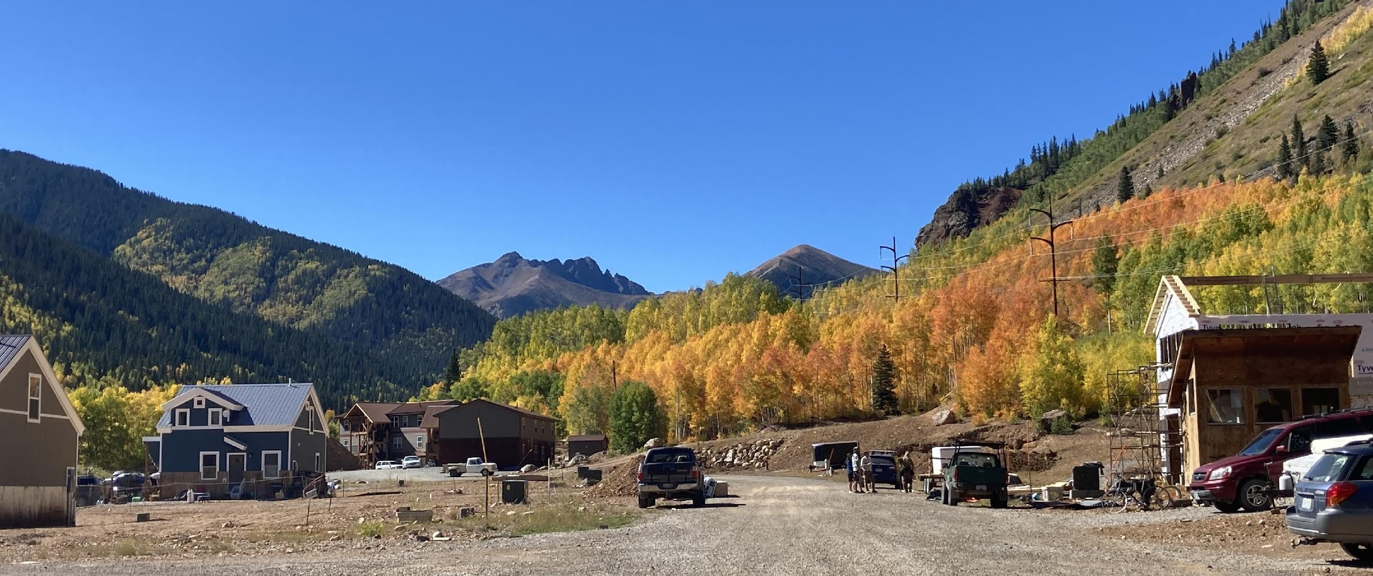
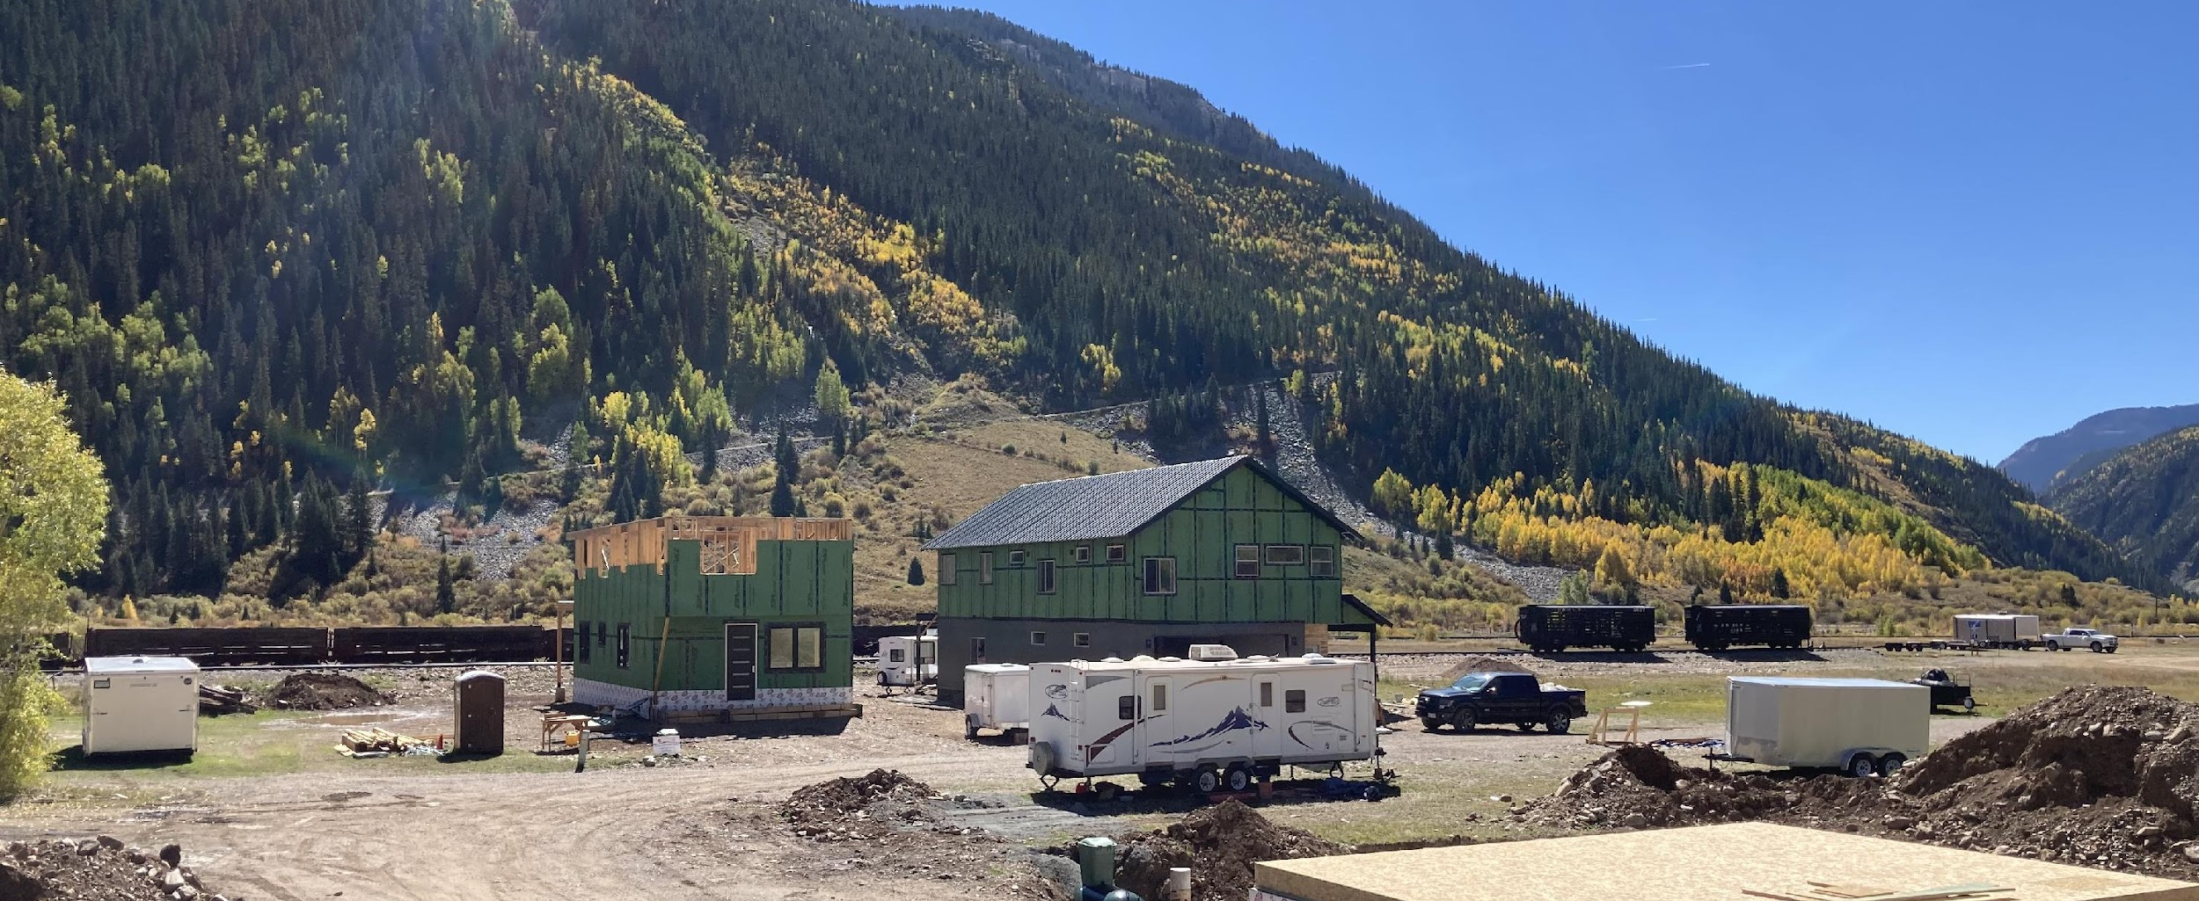
CHALLENGES
Land availability and cost
Costs of materials, professional services, labor, taxes, interest rates/cost of capital
Financing: acquisition and construction, competition and limited supply of public resources such as LIHTC and other public funding sources
Availability of developers and contractors
Infrastructure: water, utilities, roads
Regulatory barriers within your jurisdiction
Public process: uncertainty, length of time, NIMBYism
Political and staff support
Staff capacity and technical expertise
Notes:
There are a number of typical challenges that contribute to creating housing that is affordable including: Land availability, Costs, Financing for Acquisition and Construction, Availability of developers and contractors, Infrastructure, Regulatory barriers, Public process, Political and staff support; and Staff capacity and technical expertise

Slide 13
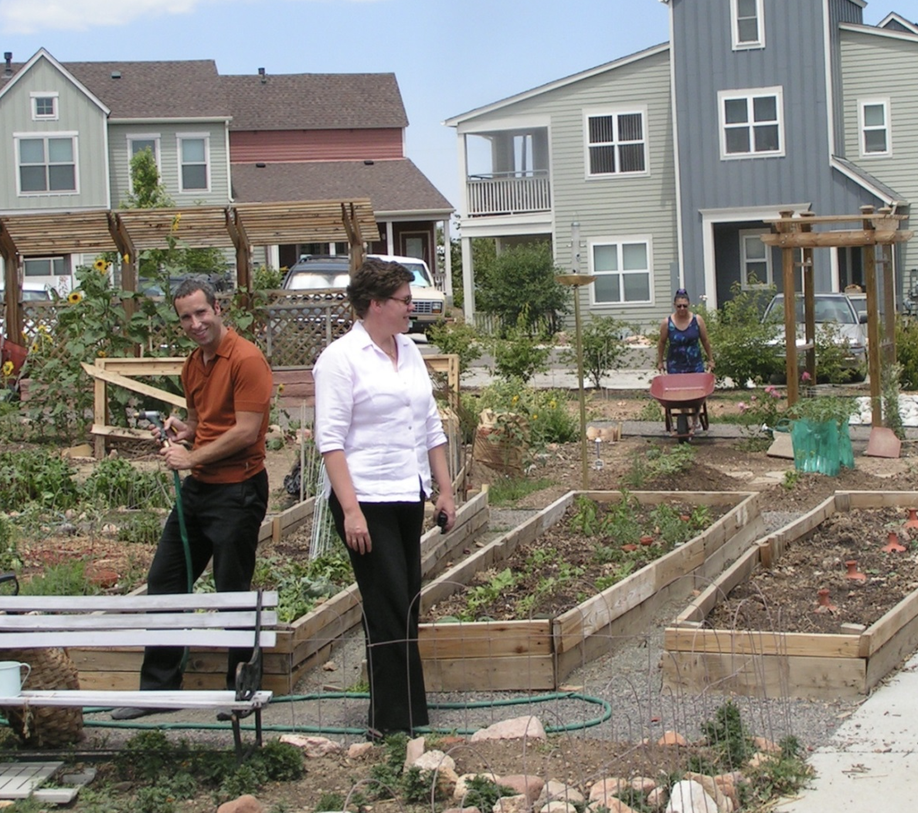
EXERCISE / DISCUSSION
What are some of the biggest barriers and challenges to housing affordability you are aware of in your community, including those listed on the previous slide or others?
How much power, influence, or other resources do you as an elected official (or other local government member you work with) have to address the barriers you see?
What have you/your community tried already? Where have you found success and what have you learned?
Notes:
Now we will take a brief pause for you to write down on your worksheet, answers to the following questions:
What are some of the biggest barriers and challenges to housing affordability you are aware of in your community, including those listed on the previous slide?
How much power, influence, or other resources do you as an elected official, or other local government member you work with, have to address the barriers you see?
What have you or your community tried already? Where have you found success and what have you learned?

Slide 14
WHAT TYPES OF HOUSING CAN MEET AFFORDABILITY NEEDS?
EXISTING
SITE USE
STRUCTURE TYPE
BUILDING
USE
TENURE
SUBSIDY
v
For- Sale
Rental
Lease-to-own
Co-housing
New construction
Redevelopment
Rehabilitation
Adaptive reuse
Accessory dwelling units
Single-family
Multi-family
Cottage Cluster
Small Homes
Manufactured
Rehab
Co-housing
Single-use residential only
Mixed-use buildings
Subsidized
Unsubsidized
Notes:
Affordable housing can refer to a wide range of housing models and development approaches. Affordable housing can be rental or for-sale; include a variety of building types that I will discuss in the following slides, It can be subsidized or unsubsidized. Depending on the need in your community, the different types of affordable housing will create options for diverse groups constituents.
Each housing type has its own characteristics, advantages and disadvantages. For example, developing any of the building types here can create more housing units with a lower development and land cost per unit compared to the same number of single-family homes. But they may also face additional community resistance in communities opposed to more dense development than what exists today.

Slide 15
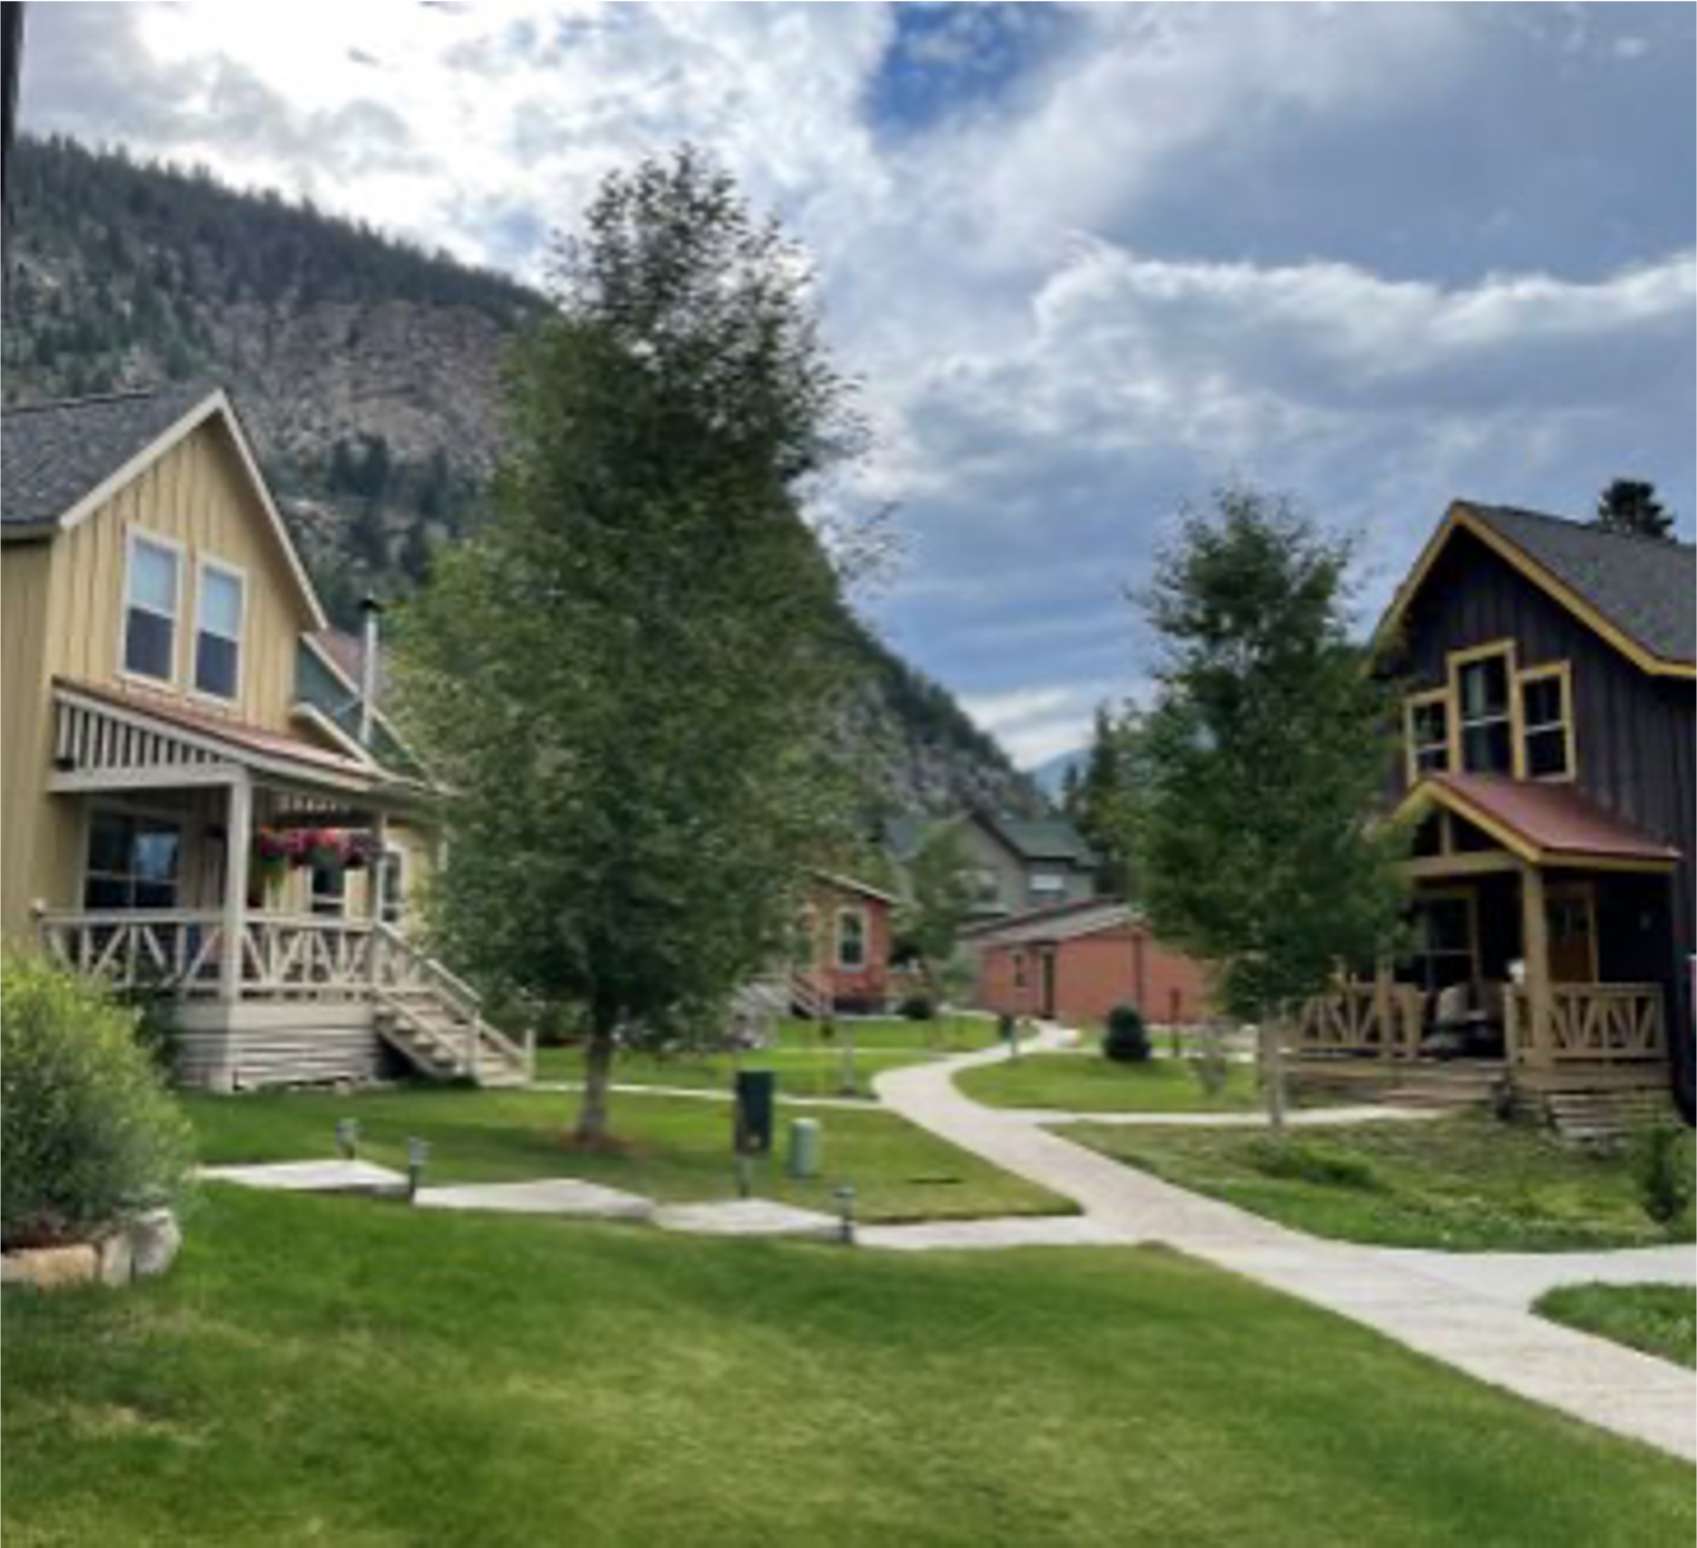
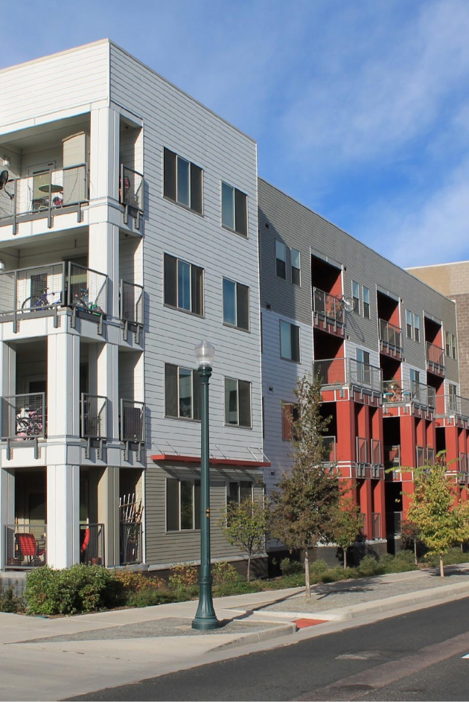
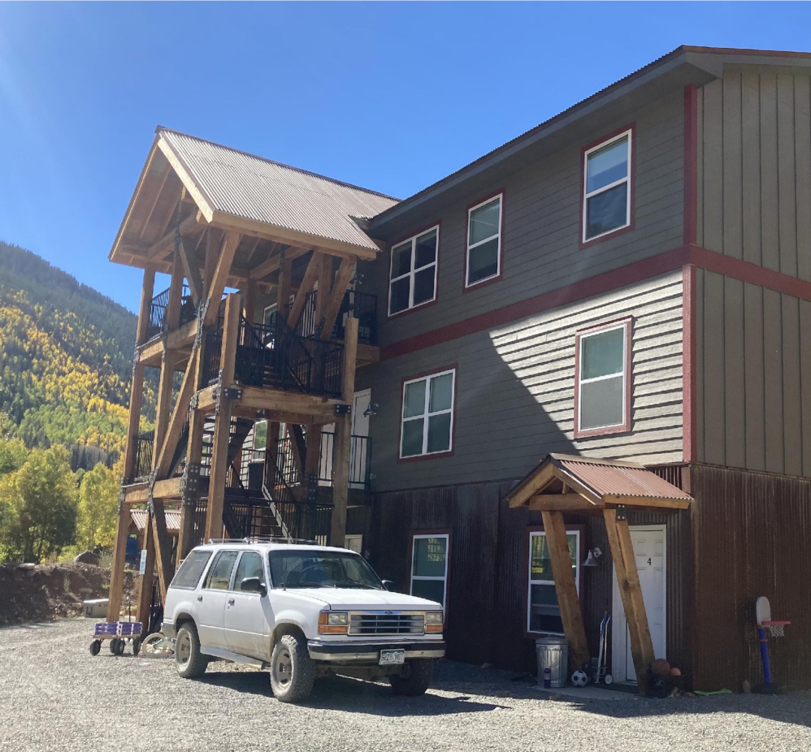
Affordable Housing
Can Take Many Shapes and Sizes
Notes:
In the next several slides, I will discuss several building types for affordable housing, most of which you are probably already familiar with.

Slide 16
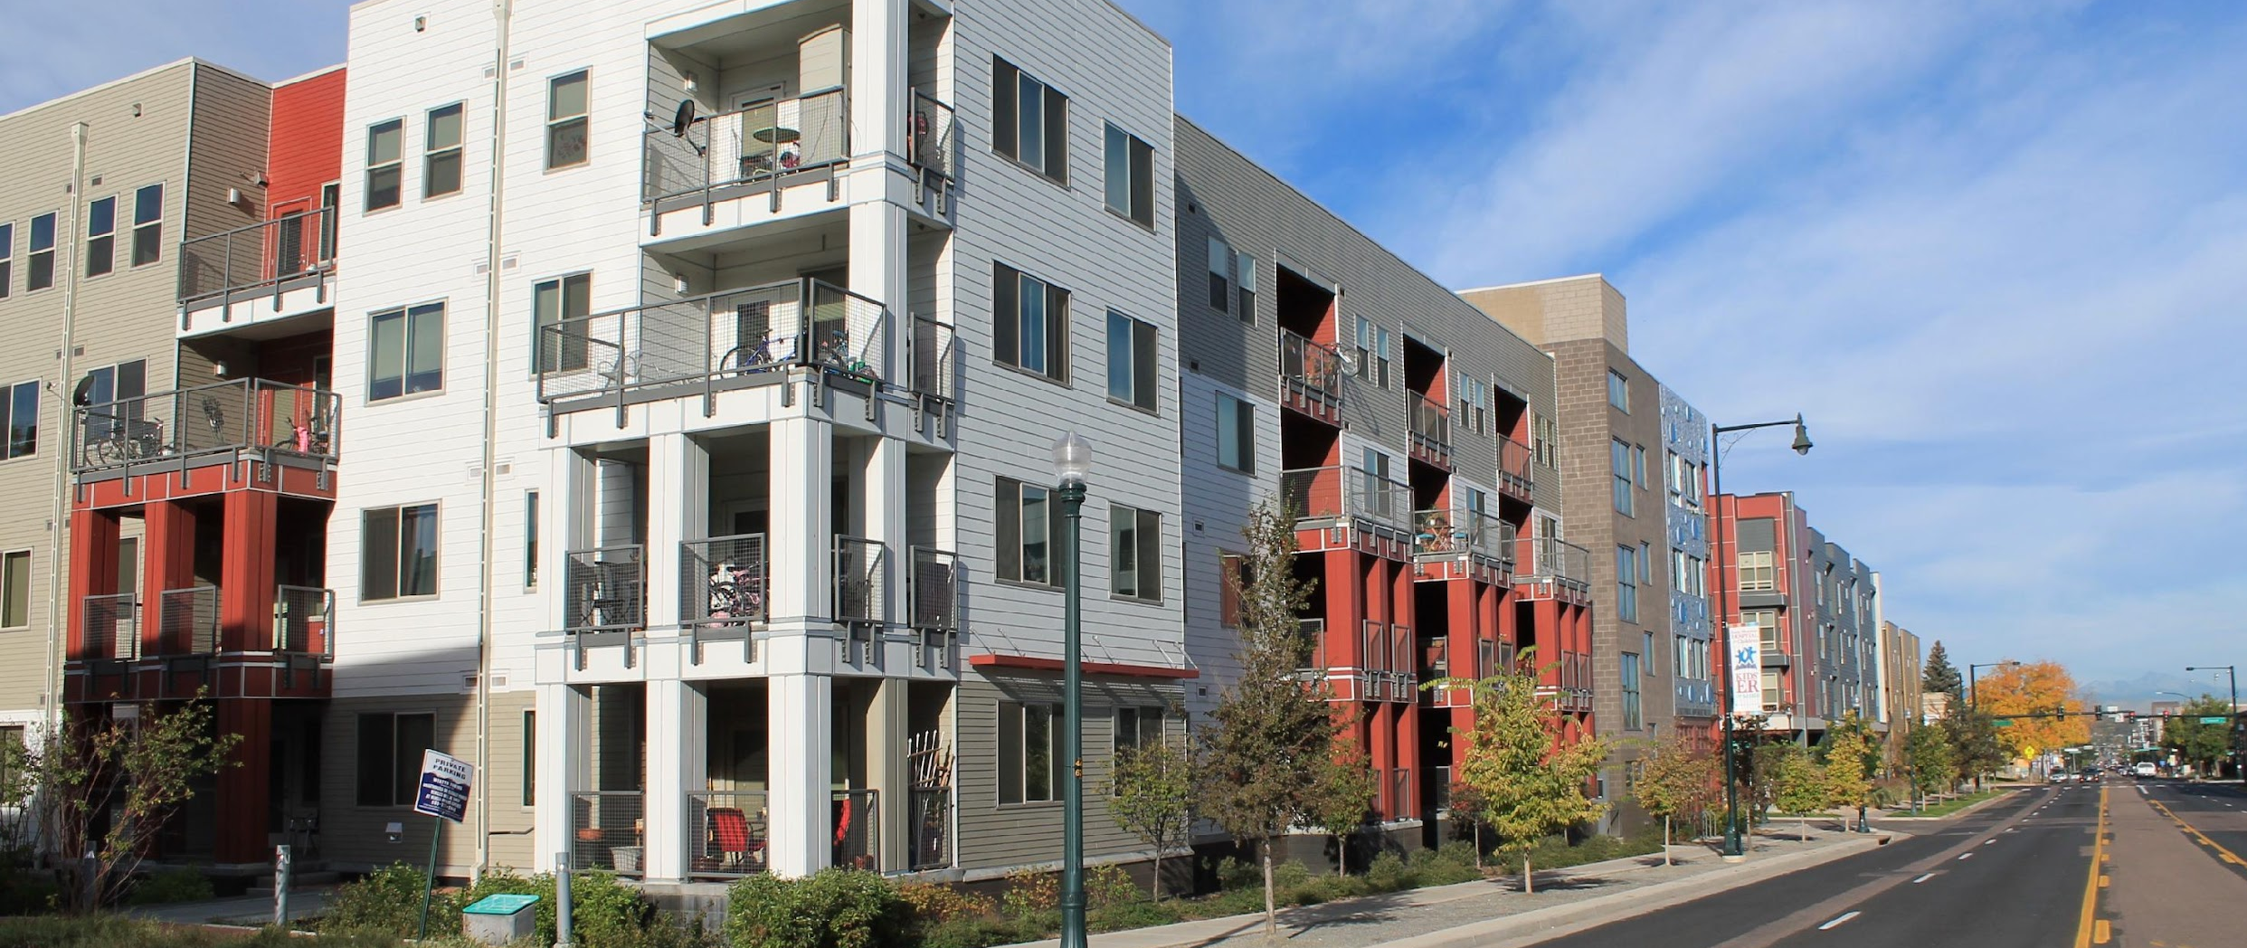
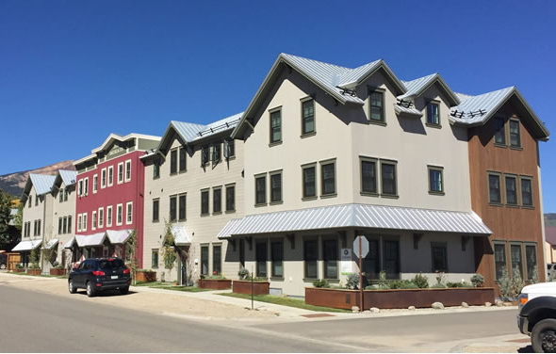
MULTIFAMILY HOUSING
Multiple housing units within the same building and lot.
Renter-occupied (apartments) or owner-occupied (condominiums) and can range from small (two- to four-unit buildings) to large (50 or more units).
Multifamily buildings create more housing units on a single site and typically result in greater density and most likely result in lower price points/more affordable units, particularly in areas with high land costs, compared to single family construction.
Communities may differ in their need for housing with more or less numbers of bedrooms to better align with the demographics in the market.
Notes:
Multifamily housing consists of multiple housing units within the same building and on the same lot. These can be renter-occupied apartments or owner-occupied condominiums and can range from small four or more-unit buildings to large 50 or more units. Communities may differ in their need for housing with more or less numbers of bedrooms to better align with the demographics in the market and to better serve families. Multifamily buildings create more housing units on a single site and typically result in greater density and most likely result in lower price points and more affordable units, particularly in areas with high land costs, compared to single family construction.

Slide 17
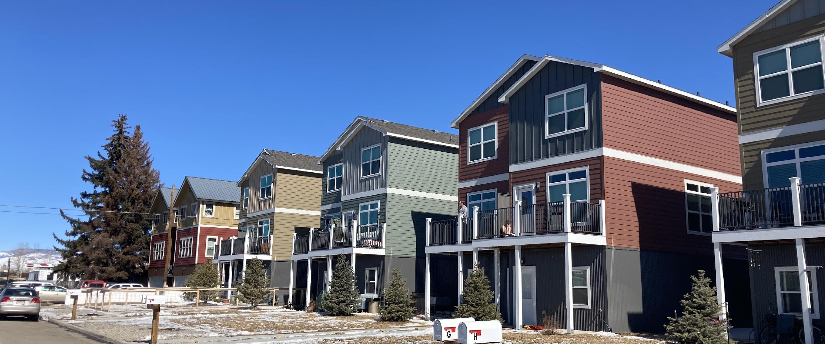
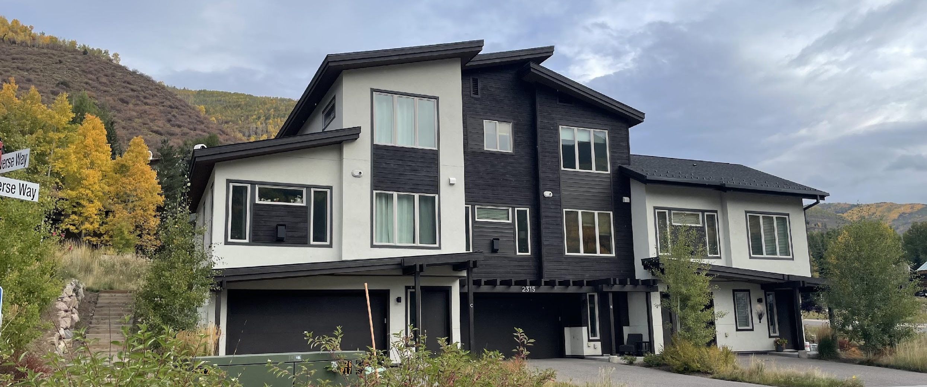
DU/TRI/QUAD PLEX
Two, three, or four housing units within the same building with shared interior walls that can be renter or owner-occupied.
Similar to multifamily buildings, these housing tryps create more housing units on a single site and typically result in greater density compared to single family construction.
For the purpose of financing and in some cases building codes, these are treated more similarly to single family homes vs. multifamily buildings.
Notes:
Du, Tri, and Quad Plexes consist of 2, 3, or 4 housing units within the same building with shared interior walls that can be renter or owner-occupied. For the purpose of financing and in some cases building codes, these are treated more similarly to single family homes vs. multifamily buildings.

Slide 18
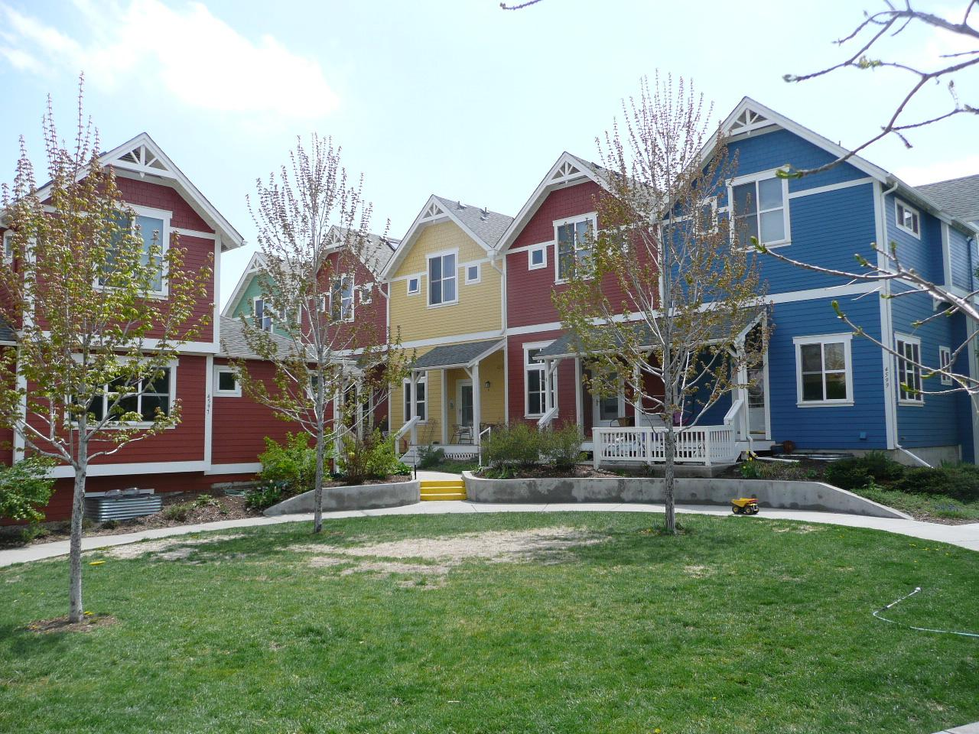
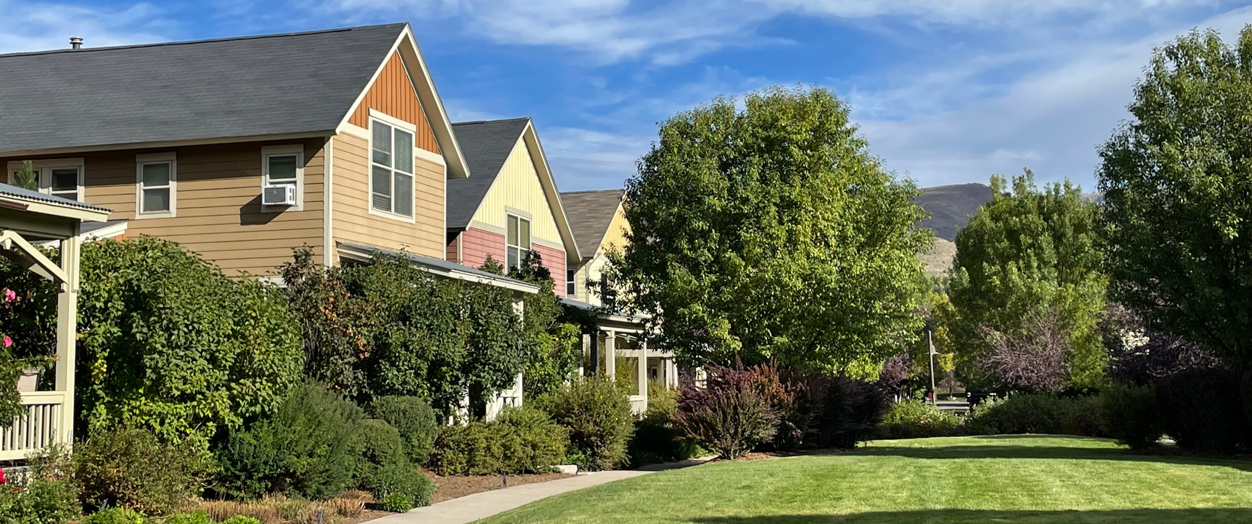
GARDEN COURTS/ CLUSTER HOMES
Typically, these consist of four or more units arranged with front doors facing a common green space with a rear alley for garage access.
These housing types create more housing units per acre and typically result in greater density compared to single family construction.
Notes:
Garden Courts and Cluster Homes typically consist of four or more units arranged with front doors facing a common green space with a rear alley for garage access. These housing types also create more units per acre and typically result in greater density compared to single family construction while having the feel similar to a single family home.

Slide 19
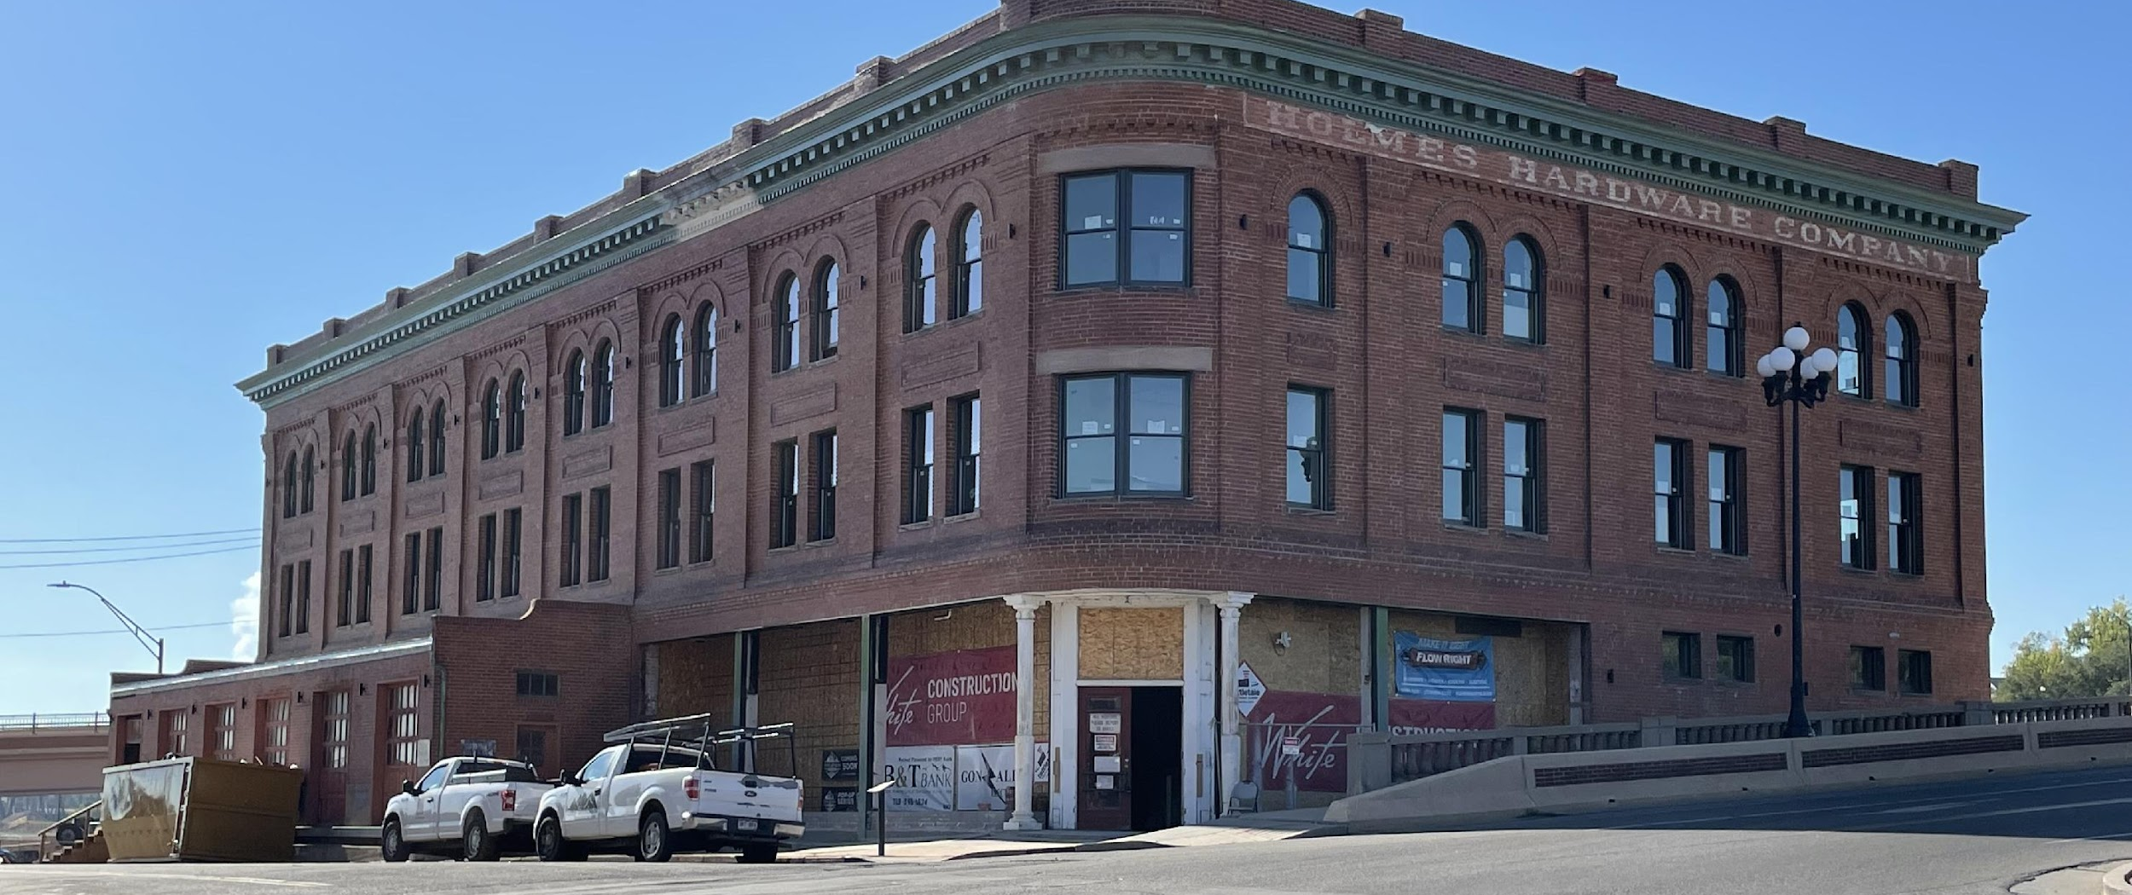
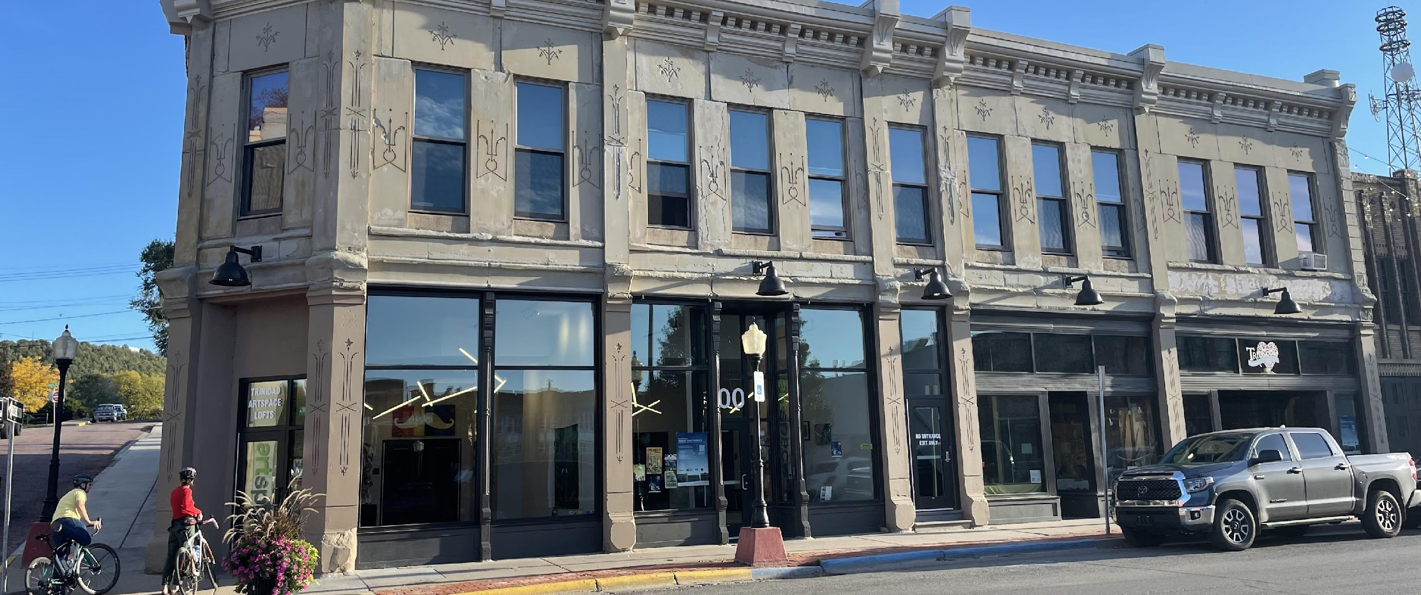
REHABILITATION AND PRESERVATION
Preservation or Rehabilitation of existing affordable housing stock that improves and maintains existing housing that might otherwise become uninhabitable or pose health and safety risks. An example would be purchasing and improving an aging apartment complex to enable it to continue to operate with affordable rents. This eliminates the cost to develop the building from the ground up as infrastructure is already in place and the entitlement process is typically already complete. It also helps current tenants remain in their community and home.
Adaptive reuse: while preservation is often less expensive than building new, adapting and rehabilitating existing buildings can still be a costly endeavor.
Notes:
Preservation or Rehabilitation of existing affordable housing stock that improves and maintains existing housing that might otherwise become uninhabitable or pose health and safety risks. An example includes purchasing and improving an aging apartment complex to enable it to continue to operate with affordable rents. This eliminates the cost to develop the building from the ground up as infrastructure is already in place and the entitlement process is typically already complete. It also helps current tenants remain in their community and home. while preservation is often less expensive than building new, adapting and rehabilitating existing buildings can still be a costly endeavor.

Slide 20
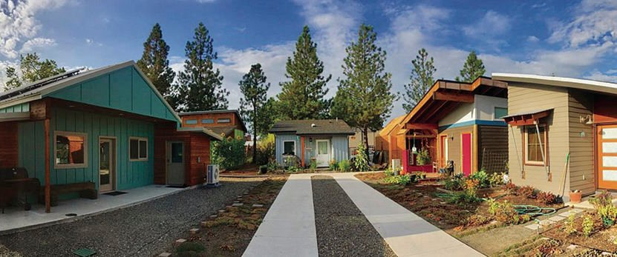
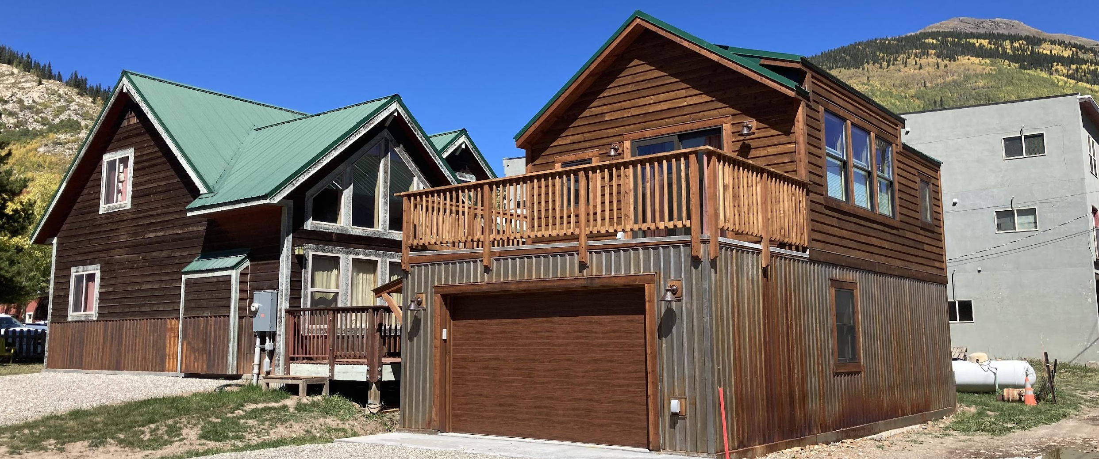
SMALL HOUSING TYPES
Tiny homes are a type of single-family home that is typically less than 400 square feet that seeks to reduce construction and operating costs and environmental impacts through building a smaller structure. Tiny homes can be developed individually but are often developed in groups as a tiny home community.
Accessory Dwelling Units (ADUs) can be a form of affordable housing in which a smaller, independent residential unit is developed on the same lot as an existing single-family home. Sometimes referred to as “grannyflats” or “accessory apartments.” The structures for ADUs can be attached, detached, or integrated into the primary building.
Small lot single family or attached homes on a lot or lots that are smaller than the typical lot in a given neighborhood or jurisdiction.
Notes:
Small Housing types include Tiny Homes, Accessory Dwelling Units (ADUs), and Small lot single family homes.
Tiny homes are a type of single-family home that is typically less than 400 square feet that seeks to reduce construction and operating costs and environmental impacts through building a smaller structure. Tiny homes can be developed individually but are often developed in groups.
ADUs can be a form of affordable housing in which a smaller, independent residential unit is developed on the same lot as an existing single-family home. Sometimes referred to as “granny flats” or “accessory apartments.” The structures for ADUs can be attached, detached, or integrated into the primary building.
Small lot single family or attached homes are built on a lot or lots that are smaller than the typical lot in a given neighborhood or jurisdiction.
These small housing types carry their own set of challenges such as regulations in the case of tiny homes and ADUs and not necessarily being as affordable as one would think due to their size. Similarly, ADUs need significant programmatic support and financing to realize at scale.

Slide 21
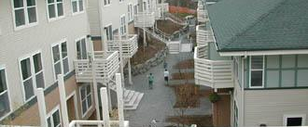
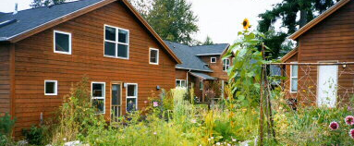
COHOUSING
In these models, each household has their own private unit or bedrooms but shares spaces and facilities such as kitchens, dining spaces, and recreation spaces with other households.
Especially common in housing designed to be multigenerational or for older adults, since they create communal living situations that increase the opportunities for social interactions.
Notes:
Cohousing is a model where each household has their own private unit or bedrooms but shares spaces and facilities such as kitchens, dining spaces, and recreation spaces with other households. These are especially common in housing designed to be multigenerational or for older adults, since they create communal living situations that increase the opportunities for social interactions.

Slide 22
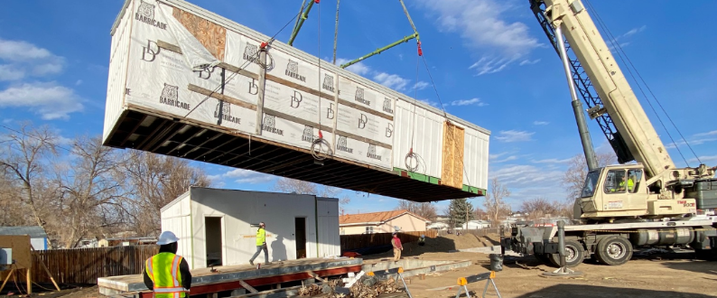
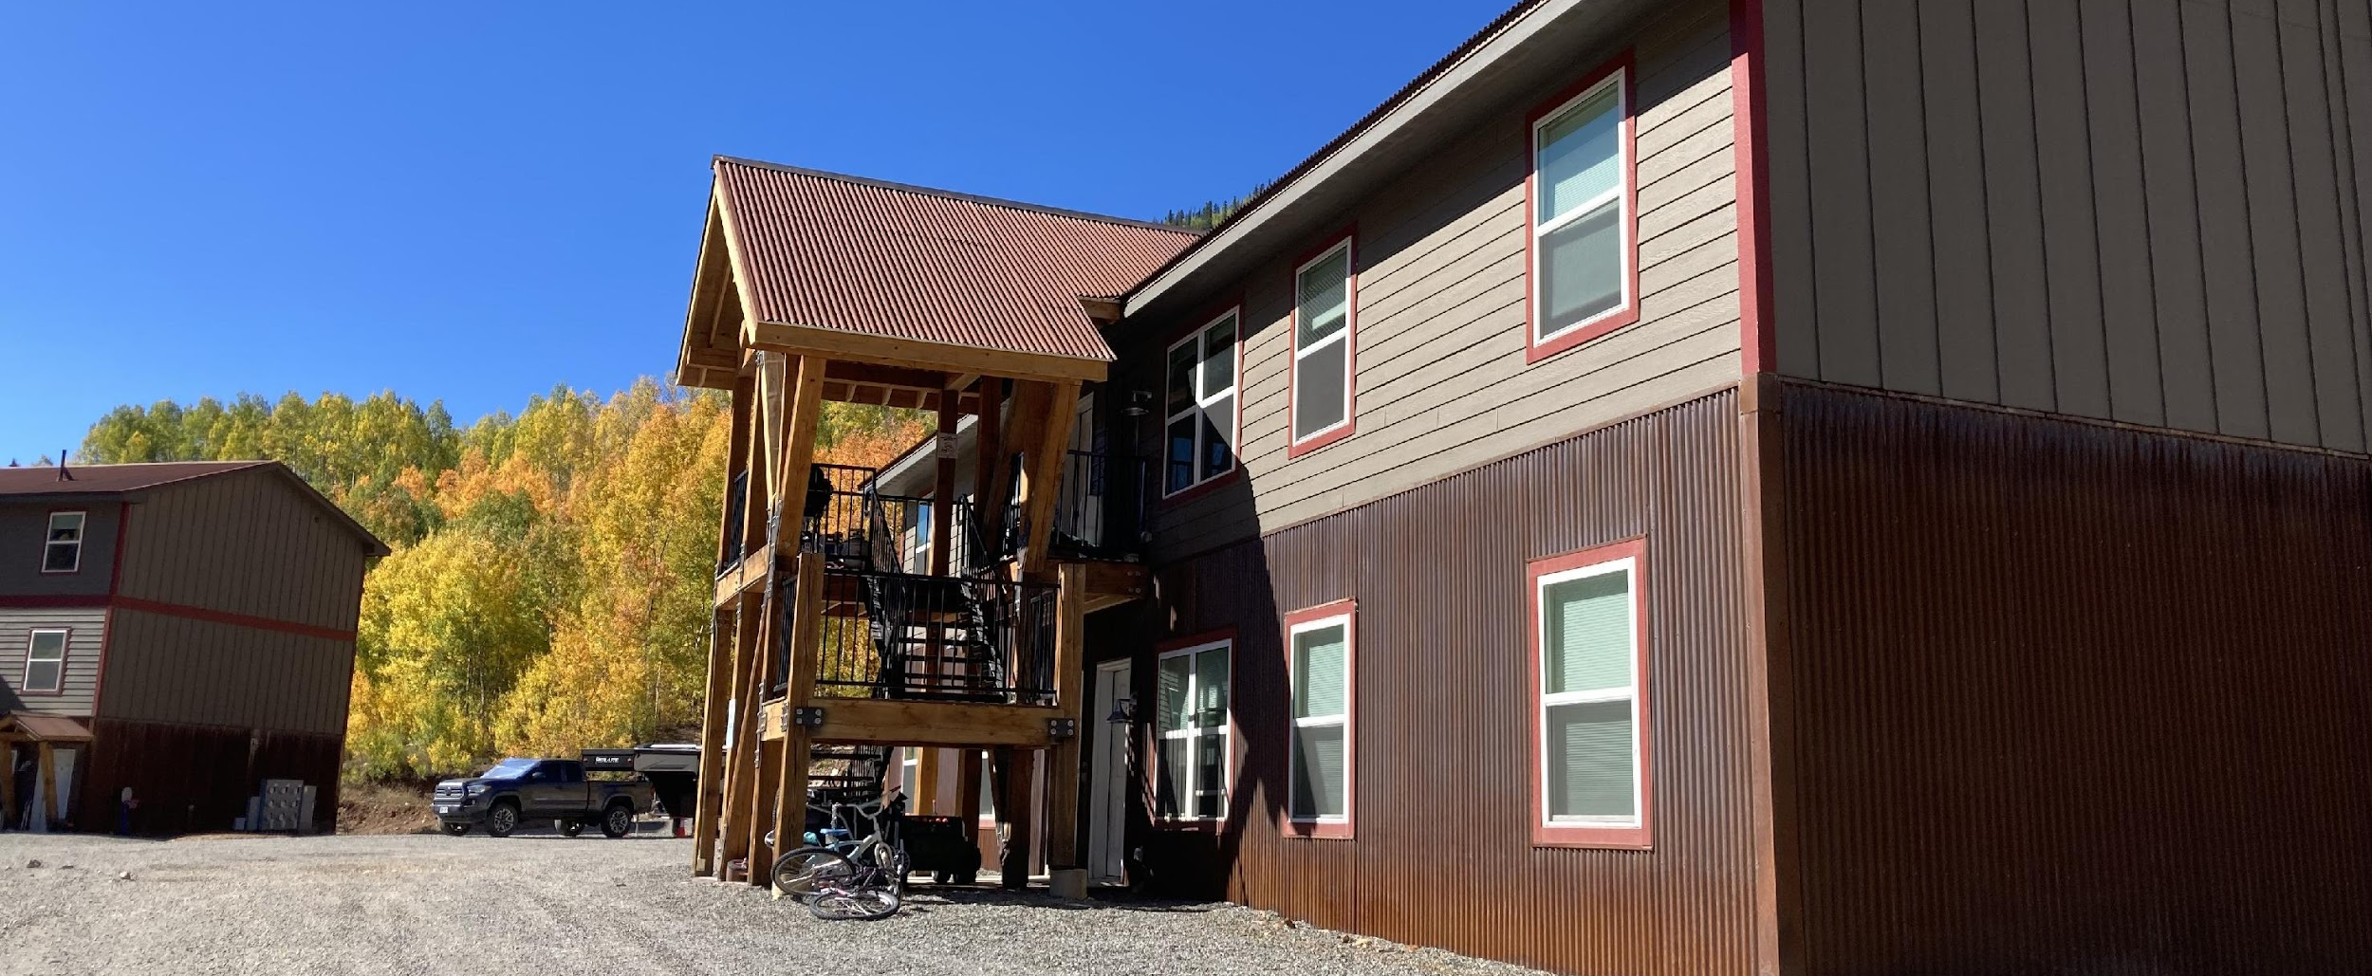
PREFABRICATED/MODULAR HOUSING
Homes built in an off-site warehouse/factory and shipped to the development location and attached to a permanent foundation. Prefabricated houses of all kinds must adhere to state and federal building codes and undergo regular inspections, just like any site-built home. This ensures that prefab homes are at least as safe as their site-built counterparts.
Benefits
  Cost savings (construction and maintenance)
  Quality control due to lack of weather issues
  Less waste
Notes:
Prefabricated or Modular Housing are homes built in an off-site warehouse or factory that are shipped to the development location and attached to a permanent foundation. Benefits include cost savings for both construction and maintenance, better quality control due to lack of weather issues, and less waste than typical on-site construction methods. Prefabricated houses of all kinds must adhere to state and federal building codes and undergo regular inspections, just like any site-built home. This ensures that prefab homes are at least as safe as their site-built counterparts.

Slide 23
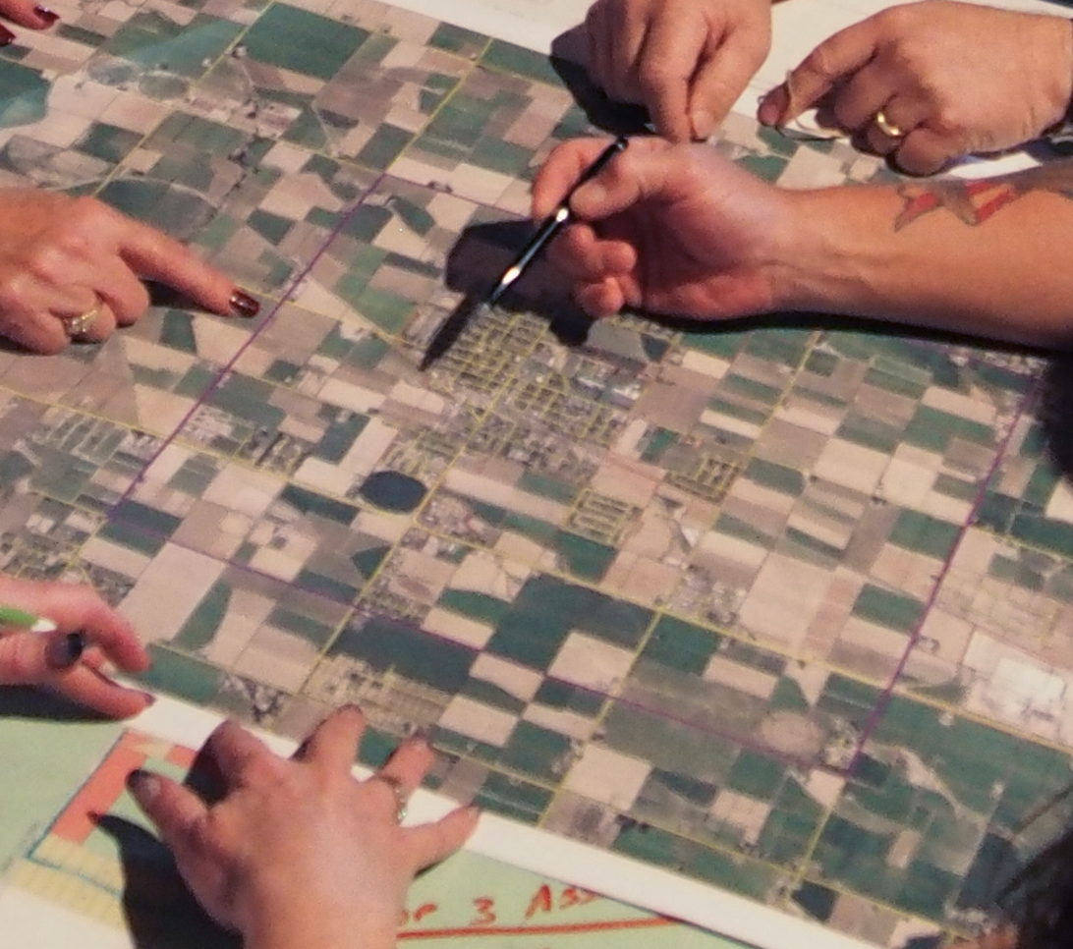
MANUFACTURED HOUSING (i.e. MOBILE HOMES)
While built in a factory like prefabs, there is no construction that happens on site.
Manufactured homes are constructed on a steel frame, shipped on its own wheels, and then laid on a crawl space, or a slab of concrete. In some cases, the wheels that got the house to the building site are not removed, rather covered up with side skirting.
Unlike prefab homes, manufactured homes only have to adhere to HUD standards (Department of Housing and Urban Development) which has much more lenient rules and regulations than state and federal building codes.
Notes:
Manufactured Housing, commonly known as Mobile Homes or trailers are also built in a factory like prefab homes, there is no construction that happens on site. Manufactured homes are constructed on a steel frame, shipped on its own wheels, and then laid on a crawl space, or a slab of concrete. In some cases, the wheels that got the house to the building site are not removed, rather covered up with side skirting. Unlike prefab homes, manufactured homes only have to adhere to HUD standards which has much more lenient rules and regulations.

Slide 24
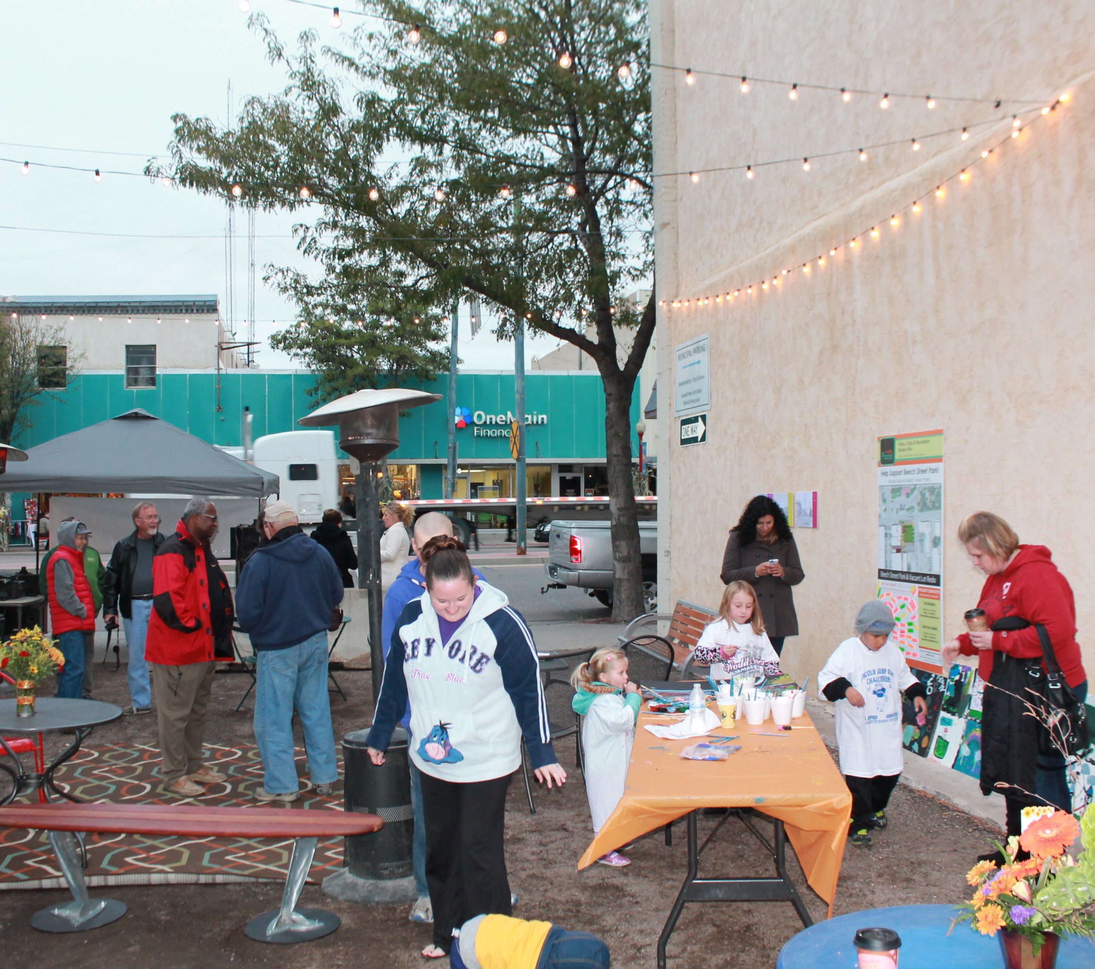
EXERCISE / DISCUSSION
Given the range of housing types described in this section, what types are you interested to learn more about?
What housing types do you think would help address some of the housing needs in your community? Has your community been successful in developing these types of housing in recent years? Why/why not?
How supportive are your community members/constituents to the types of housing you think are needed? What could you do in your role to improve support where it’s lacking?
Notes:
For our next exercise, we'd like you to answer the following questions:
Given the range of housing types described in this section, what types are you interested to learn more about?
What housing types do you think would help address some of the housing needs in your community? Has your community been successful in developing these types of housing in recent years? Why or why not?
How supportive are your community members and constituents to the types of housing you think are needed? What could you do in your role to improve support where it’s lacking?

Slide 25
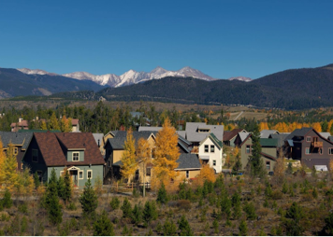
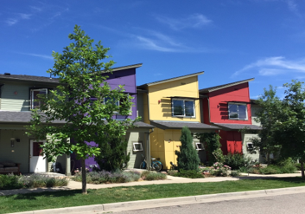
Role of Local Government
Notes:
No we are going to talk about the role of local governments in getting successful developments built.

Slide 26
KEY LEVERS LOCAL GOVERNMENTS CAN USE TO IMPACT LOCAL DEVELOPMENT
Needs Assessment, Vision, Strategy
Policy And Regulatory Environment
Incentives
Direct Participation in Development
Building Support
Notes:
Key levers local governments can use to impact local development include a Needs assessment, Vision, and Strategy:
Policy and regulations, Incentives, Direct participation in development, and Building community support

Slide 27
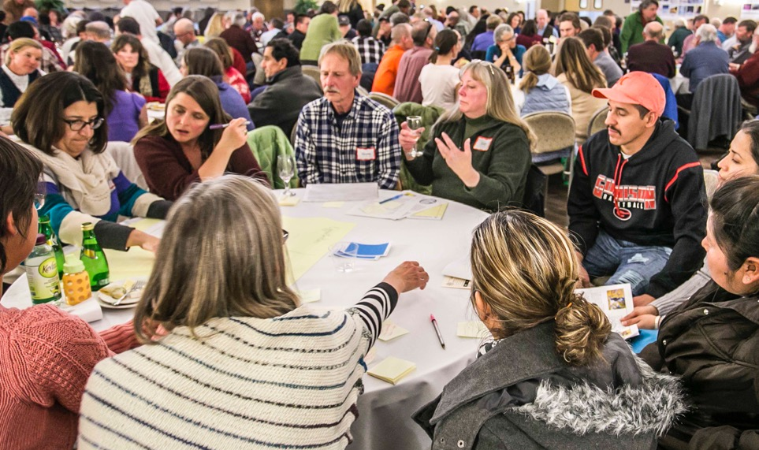
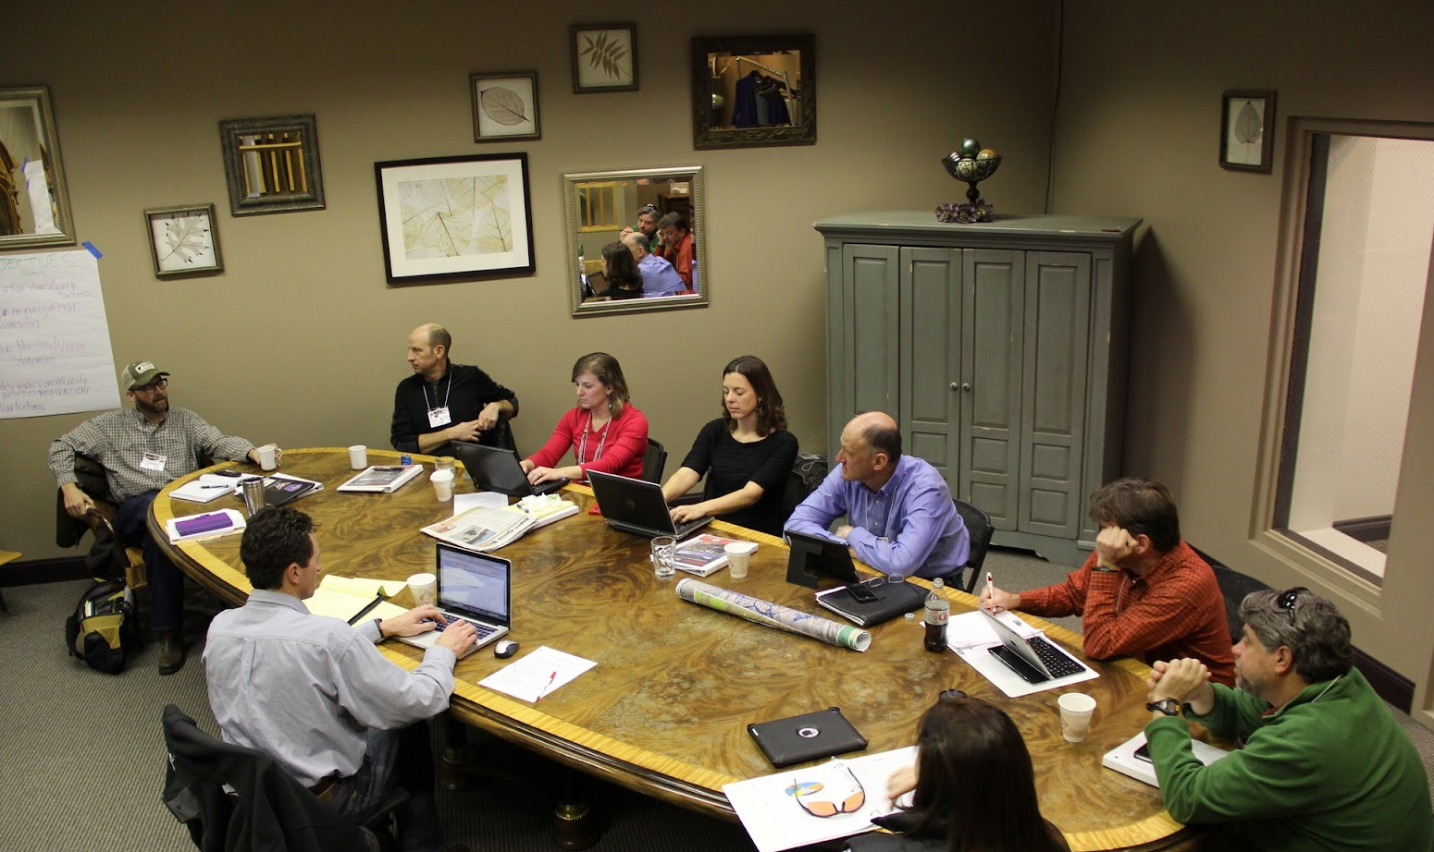
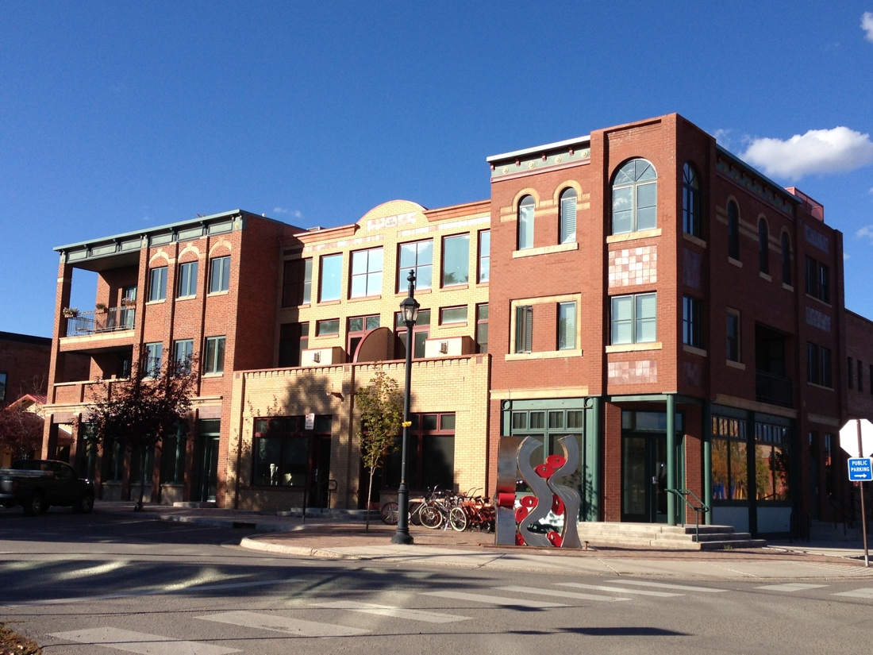
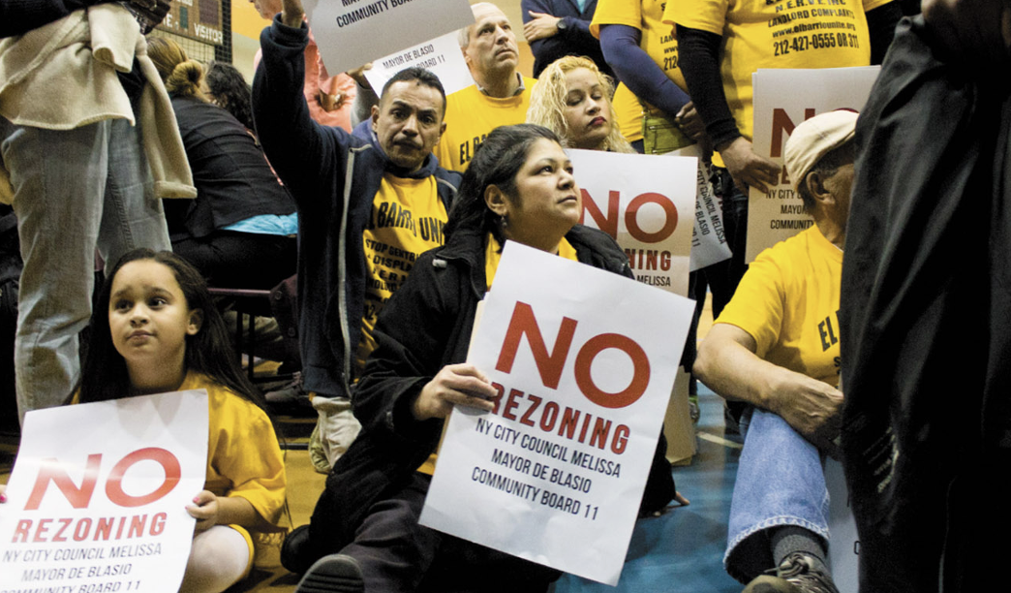
CREATE A LOCAL HOUSING STRATEGY
People and Partnerships
Market Intelligence
Vision and Goals
Strategies and Tactics
Regional Coordination/create a regional housing authority
Public Support and Political Will
Notes:
First, you should develop a local housing strategy which includes:
Creating Partnerships and including people who have different opinions and expertise on the work being done. It’s critical to include people who represent the community’s diversity. This group usually includes key local leaders and a mix of public, private and likely non-profit entities.
Understanding your Market
Some communities may be resistant to new development occurring, while others may welcome it. Thus, consideration for the local housing market context is critical. A Housing Needs Assessment is an in-depth study, usually conducted by an independent market analyst, to evaluate how well the market is meeting the housing needs of different income levels. In most cases, the assessment quantifies how many units are needed by price point, tenure, housing type, and demographic or market segment.
Your local government should identify high-level and meaningful vision and goals that enable you and the general public to track your jurisdiction’s overall progress in achieving your housing policy objectives.
You should identify potential strategies and tactics to create new affordable housing in your community. Some examples include creating more land-efficient strategies such as infill, preservation and redevelopment of existing housing, land banking, and greater density allowances where appropriate.
Many jurisdictions in Colorado are part of a larger region where jobs may not be in the same city, town, or unincorporated area where people live. In these regions, it may be more beneficial to create a regional housing strategy versus each having their own. This would allow for jurisdictions to begin to support or develop projects outside of their jurisdictional boundaries. One option would be to create a regional housing authority. This would require engagement of local and regional leaders to build a shared understanding, and align regional partners, around housing goals and strategies for shared priorities. It would also allow for cross jurisdictional sharing of resources and funding. There are many examples of regional housing authorities throughout Colorado.

Slide 28
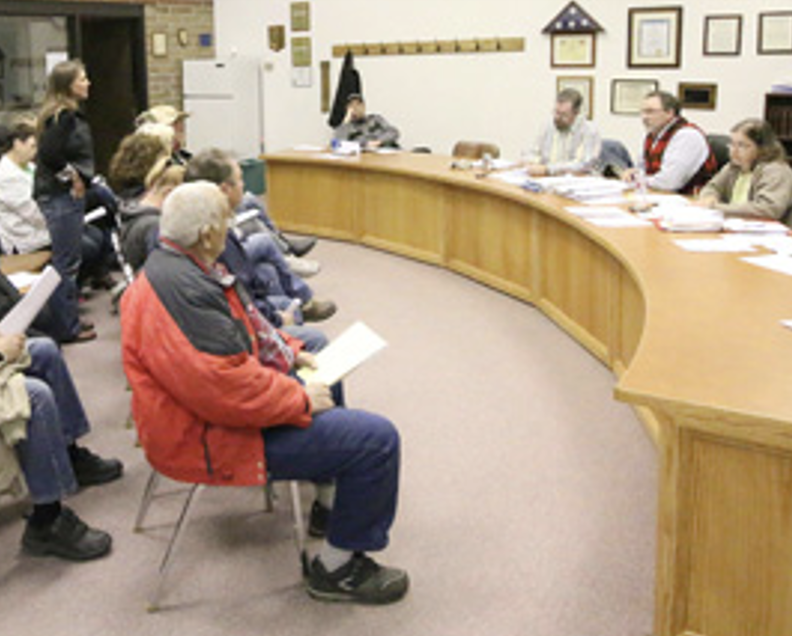
EXERCISE / DISCUSSION
What is the political will for affordable housing development in your community?
What regional coordination exists, if any, for affordable housing development in your region?
Is your region a potential candidate to create a regional housing authority? Would you like additional information about the steps involved?
Notes:
For this next discussion, we would like you to answer the following questions:
What is the political will for affordable housing development in your community?
What regional coordination exists, if any, for affordable housing development in your region?
Is your regional a potential candidate to create a regional housing authority? Would you like additional information about the steps involved?

Slide 29
ALIGNING PLANS & POLICIES TO EXPAND HOUSING CHOICES AND AFFORDABILITY – REMOVE BARRIERS
    Expedite review and permitting process: reduced time for affordable developments
    Update/modify zoning and development codes
    Update or modify Dimensional Standards
    Increase housing types allowed in multiple zone districts: i.e. du & triplex in single family zones
    Allow greater housing capacity by right: I.e. increase number of units allowed per lot, increase floor area ratio
Notes:
Next we will discuss aligning plans & policies to expand housing choices and affordability.
One way to do this is to remove barriers such as the review and permitting process. As the expression goes, time is money, and this is especially true for developers. These barriers can make the difference in a project’s financial feasibility for the developer.
Other typical barriers include dimensional standards such as minimum lots sizes and excessive setbacks.
Increasing allowable housing types in zone districts not only provides variety, but can reduce land and building costs as discussed previously.
Eliminating use restrictions that prohibit residential uses in core areas by making desired housing choices use-by-right in key locations reduces the amount of time it takes for projects to be reviewed and approved because they do not require special approvals or variances.

Slide 30
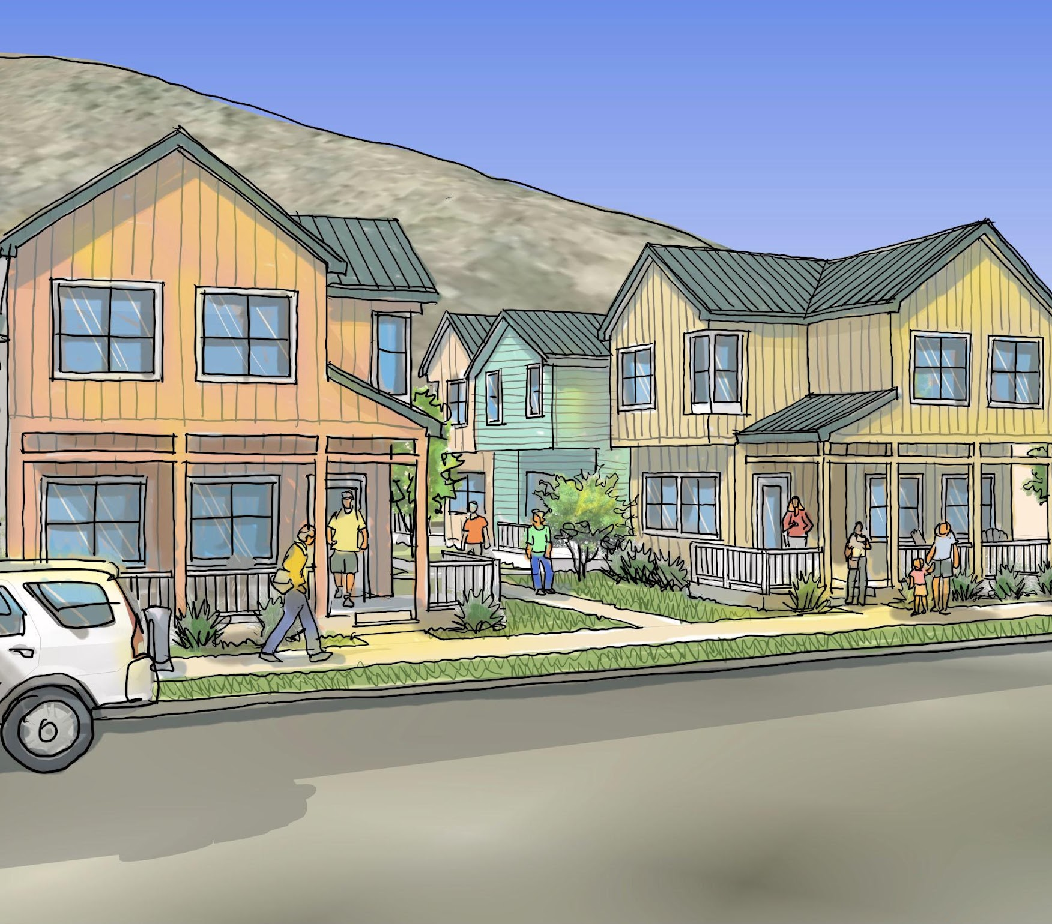
ENCOURAGE AFFORDABILITY WITH INCENTIVES
    Provide land and infrastructure at a reduced or no cost (See Silverton-Anvil case study)
    Reduce minimum lot sizes and minimum home sizes
    Reduce number of parking spaces required per unit
    Increased height and density bonuses (could be based on percent or number of affordable units provided)
    Reduced development fees
Notes:
Incentives are another way local governments can encourage affordability. Some incentives to consider include:
Provide land and infrastructure at a reduced or no cost,
Reduce the minimum lot sizes and minimum home sizes,
Reduce number of parking spaces required per unit,
Increased height and density bonuses which could be based on a percent or number of affordable units provided, and
Reduce the development fees for affordable housing developments

Slide 31
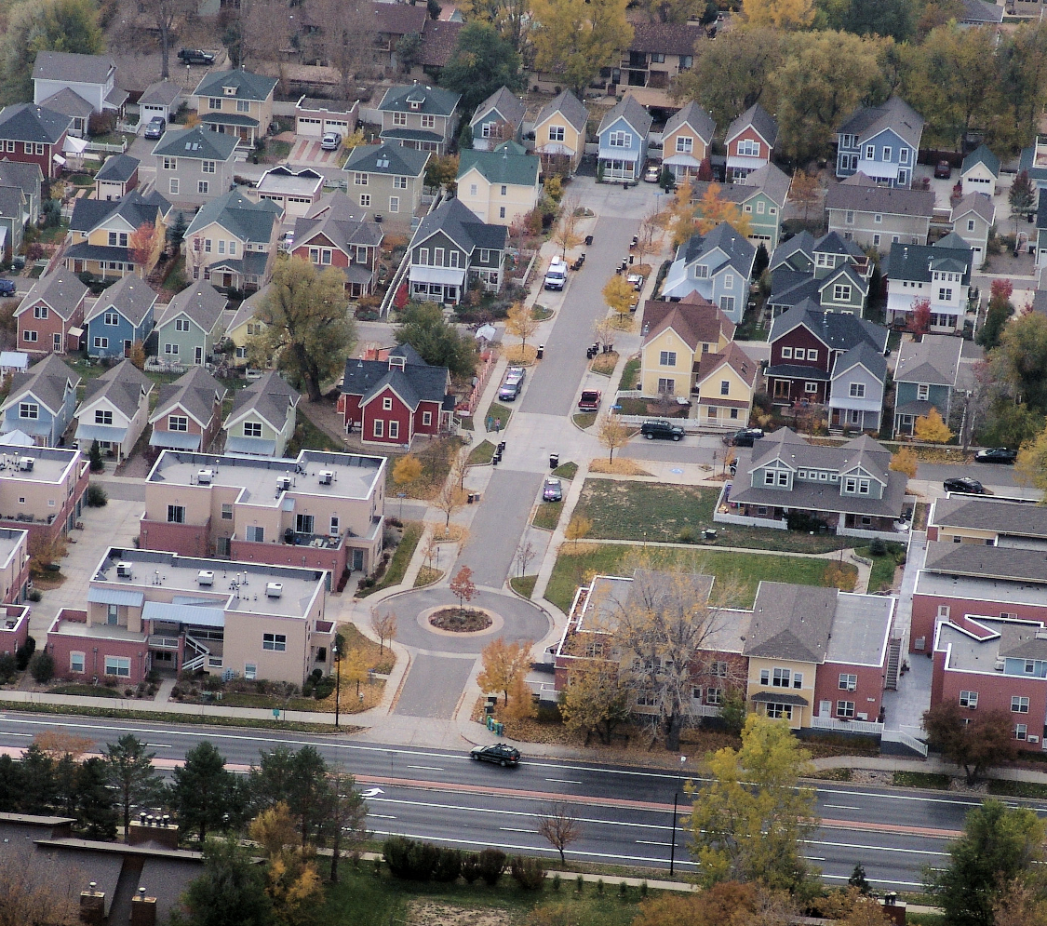
EXERCISE / DISCUSSION
  What specific barriers exist in your code? Are there others? What changes/updates (if any) is your community working on?
  What incentives has your community tried already? Have these led to additional affordable housing units?
Notes:
For our next exercise, please answer the following questions:
What specific barriers that we discussed exist in your code? Are there others? What changes or updates is your community working on?
What incentives has your community tried already? Have these led to additional affordable housing units?

Slide 32
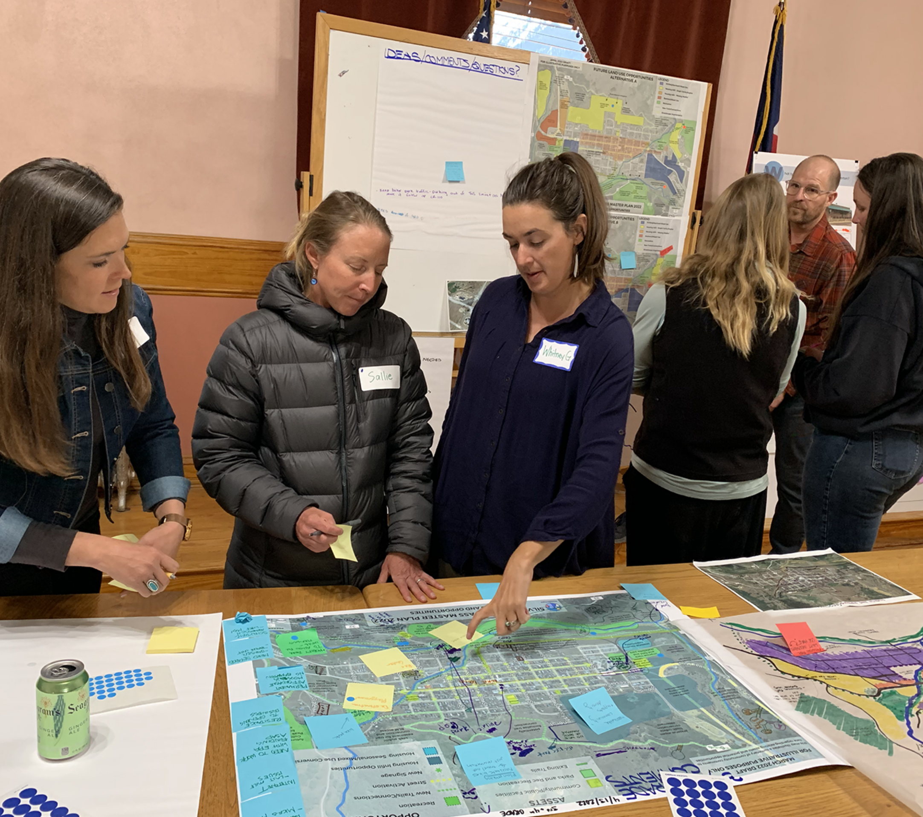
DEVELOPMENT ROLES OF LOCAL GOVERNMENT
Primary Developer Role
Development Partner
    Partner with private developer(s), non-profit developer, public housing authority, community land trusts, public utilities, local anchor institutions/major employers, school districts
    Funding Partners
    Operator/Managment
Notes:
There are many roles your local government can take in the development process:
Active local government participation can lower the risk, reduce costs by streamlining some of the processes, and help to develop the best product to meet local needs. While not common, it is possible for a local government to take on the primary development role. In order to do this, you must be certain you can manage a project and provide backbone support to the effort.
You also need to have keen understanding of what project or initiative is needed in your community, community credibility and political capital, and staying power to see the project through the many years that are needed to plan, build and operationalize a housing development.
More commonly, local governments partner with one or more of the following: private developers, non-profit developers, a public housing authority, a community land trust, public utilities, or local anchor institutions such as major employers or school districts.
One of the most important roles a local government can take is being a primary funding partner in the form of assisting with the creation, allocation and/or administration of local, state and federal funds; providing staff time for planning or project management; providing land appropriate for development; providing operations or project management capacity; and, proving property tax exemptions.

Slide 33
COMMUNITY LAND TRUST (CLT)
  A community-based organization designed to ensure community stewardship of land, primarily used to ensure long-term housing affordability. The trust typically acquires land and maintains ownership of it permanently.
  It enters into a long-term renewable lease with homeowners instead of a traditional sale. When the homeowner sells, the family earns a portion of the increased property value. The remainder is kept by the trust, preserving the affordability for future low- to moderate-income families
  CLTs are generally managed by a nonprofit or quasi-governmental organization and governed by a body comprised of purchasers of CLT homes, members of the public, and governmental and nonprofit stakeholders to ensure they remain grounded in the needs of the community.
Notes:
A Community Land Trust is a community-based organization designed to ensure community stewardship of land, primarily used to ensure long-term housing affordability. The trust typically acquires land and maintains ownership of it permanently. It enters into a long-term renewable lease with homeowners instead of a traditional sale. When the homeowner sells, the family earns a portion of the increased property value. The remainder is kept by the trust, preserving the affordability for future low- to moderate-income families. CLTs are generally managed by a nonprofit or quasi-governmental organization and governed by a body comprised of purchasers of CLT homes, members of the public, and governmental and nonprofit stakeholders to ensure they remain grounded in the needs of the community.

Slide 34
MAJOR COMMUNITY LAND TRUSTS IN COLORADO
Elevation Community Land Trust works throughout the state and is one of the largest CLTs in Colorado and the country
  Urban Land Conservancy based in Denver, predominantly works in Denver metropolitan area
  Colorado Community Land Trust (CCLT) recently merged with Habitat for Humanity - predominantly works in Denver metropolitan area
  Chaffee Housing Trust provides affordable housing to Chaffee and Lake County residents
Notes:
There are four major Community Land Trusts in Colorado that your local government could potentially partner with, depending on your location:
Elevation Community Land Trust works throughout the state and is one of the largest CLTs in Colorado and the country.
The Urban Land Conservancy based in Denver, predominantly works in Denver metropolitan area
The Colorado Community Land Trust (CCLT), which recently merged with Habitat for Humanity also predominantly works in Denver metro area
And the Chaffee Housing Trust which provides affordable housing to Chaffee and Lake County residents

Slide 35
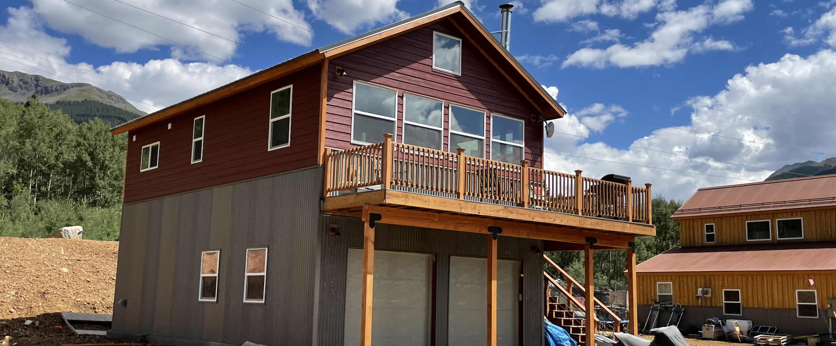
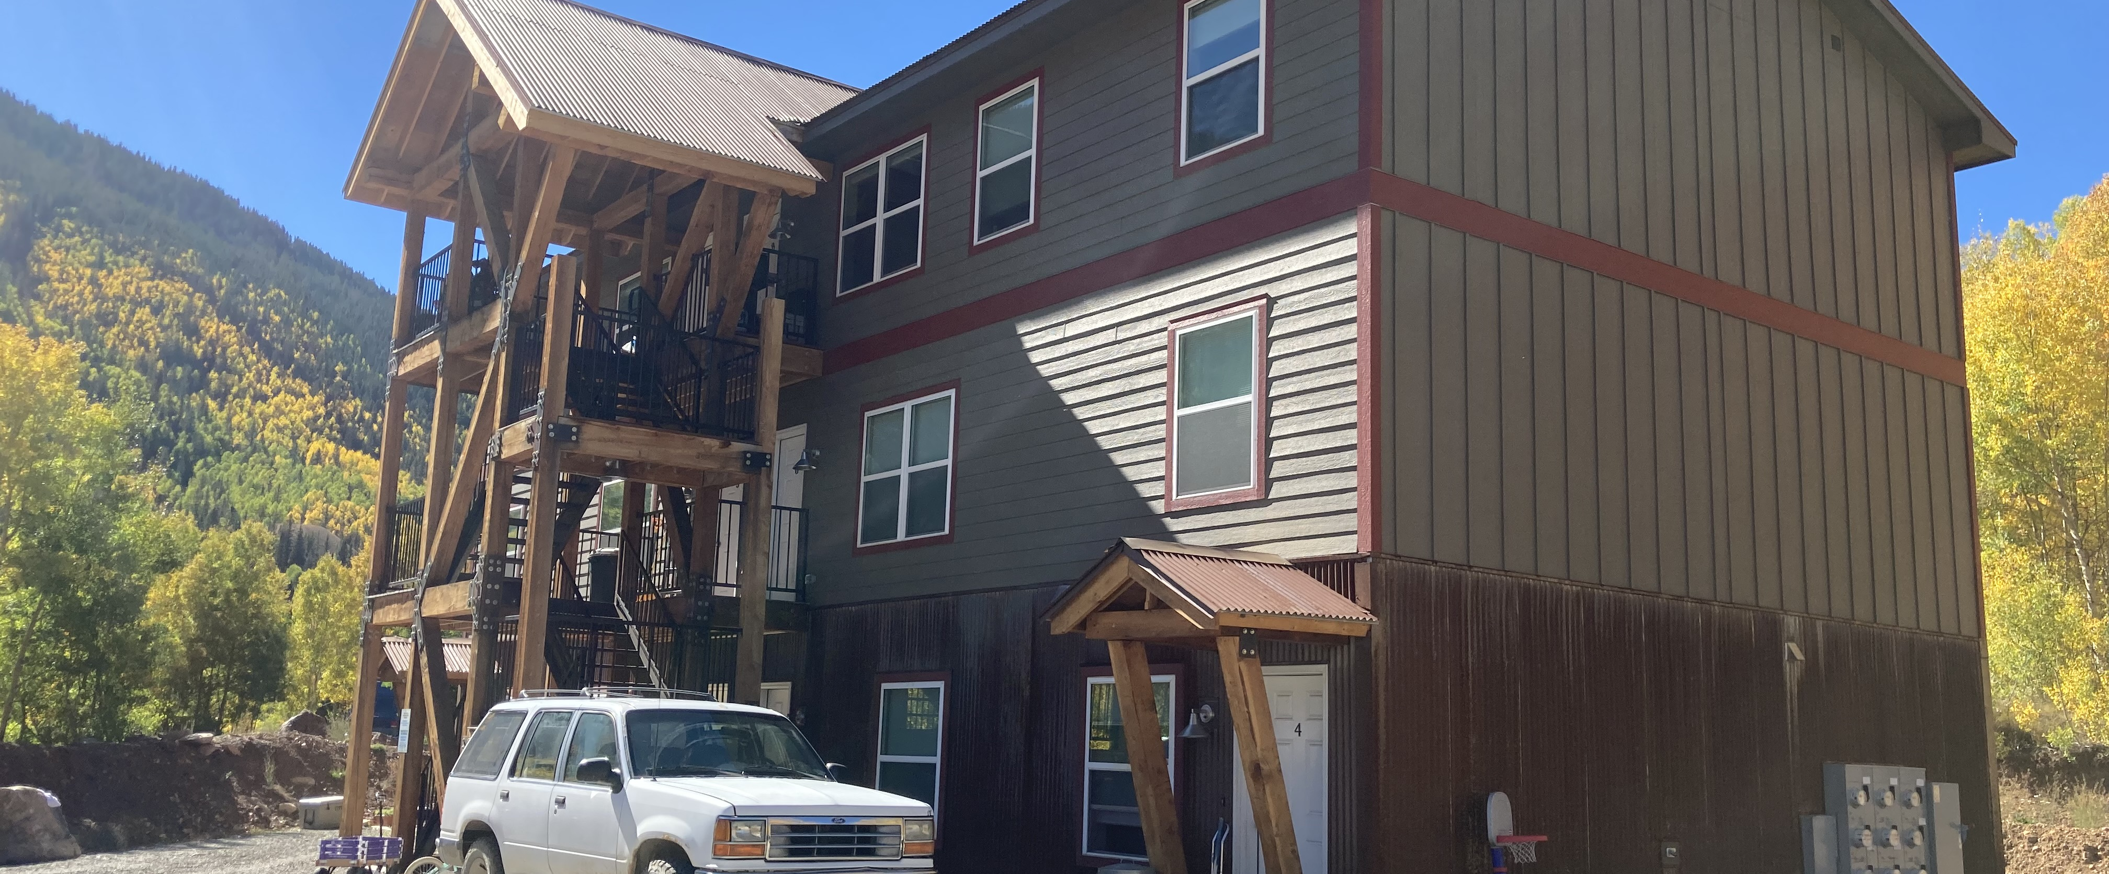
PUBLIC – PRIVATE PARTNERSHIP CASE STUDY
Anvil Mountain Development – Silverton, CO
  San Juan County used fees in lieu from the Purgatory Ski Resort affordable housing development fund to purchase land in Silverton and utilized DOLA grants to build infrastructure. I
  Due to the inability to find interested developers, San Juan County acted as the developer for the affordable apartment complex.
  Use of modular apartments allowed the County to build economically & quickly.
  The county provided a streamlined development review process.
Notes:
As part of the local officials toolkit, we have provided several case studies that are highlighted in videos available on the DOLA/DOH website.
The Anvil Mountain Development in Silverton, CO is a great example of a public private partnership.
San Juan County used fees in lieu from the Purgatory Ski Resort affordable housing development fund to purchase land in Silverton and utilized DOLA grants to build infrastructure. Due to the inability to find interested developers, San Juan County acted as the developer for the affordable apartment complex.
The use of modular apartments allowed the County to build economically & quickly and the county provided a streamlined development review process.

Slide 36

EXERCISE / DISCUSSION
  In order undertake a new affordable housing development in your community, what is your local governments’ internal capacity? What are your deficiencies, and gaps?
  What partnerships and consultant assistance may be required to complete a housing development?
Notes:
For this next discussion, we would like you to answer the following questions:
In order undertake a new affordable housing development in your community, what is your local governments’ internal capacity? What are your deficiencies and gaps?
What partnerships and consultant assistance may be required to complete a housing development in your community?

Slide 37
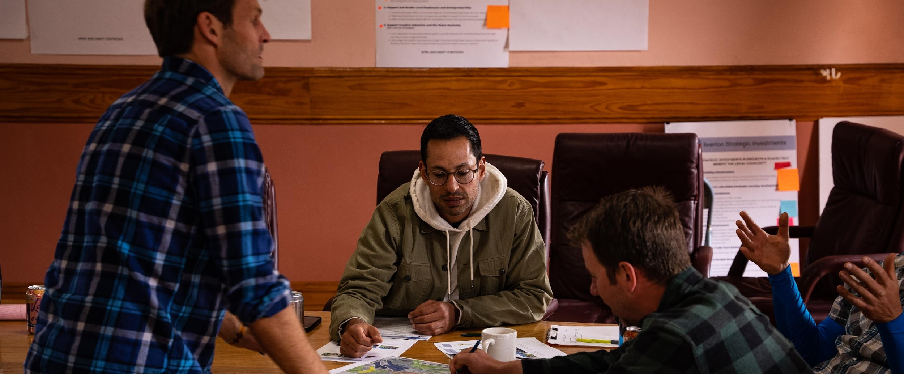
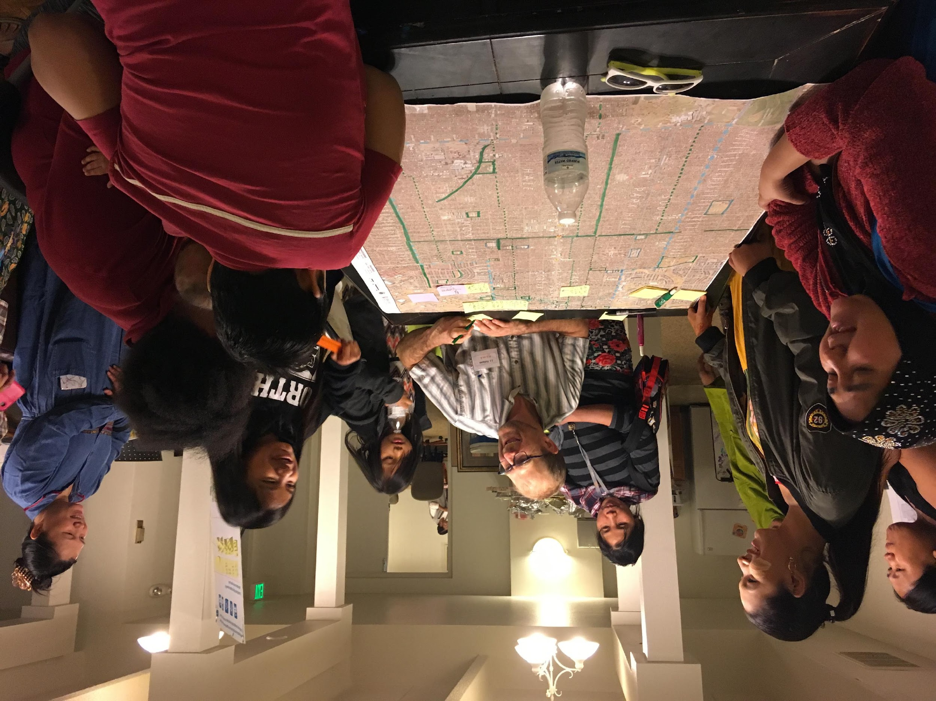
BUILD LOCAL SUPPORT
Building support by Local Officials
Bringing the community together and identifying champions
How to handle outreach to specific underserved populations
Race, Equity and Inclusion
Notes:
In addition to assisting with removing policy barriers to affordable housing as described previously, it is important that local officials politically support affordable housing initiatives in your community. Local officials should be promoting housing affordability as a positive and important factor in improving neighborhood conditions by demonstrating that affordable housing is a community asset, providing housing for the workforce and local jobs during and after construction, bringing in federal and state subsidies, generating sales tax revenue, and reducing traffic and pollution. For local officials that may NOT support affordable housing developments, it is important to provide them with factual information about the housing need and positive impacts in your community.
It is important to build awareness for the current housing need and what affordable housing solutions exist that address the unique context of your community. Include residents and constituents within the conversation about development and how more options for affordable housing can benefit your community. You should encourage community participation in the process to learn about residents’ housing needs. Engaging with the community will identify high priority challenges in addition to providing an opportunity to address concerns about affordable housing development.
Public support is also needed to achieve meaningful policy change that enables the expansion of housing choices. Despite its importance, many communities have difficulty building support for affordable housing. The “Not In My Back Yard” syndrome, or NIMBY, is the tendency of neighbors to oppose a proposed project, often based on misconceptions or fears that property values, safety, or quality of life will be compromised. For affordable housing projects to be successful, outreach that builds and maintains community support should begin in the early stages of the development process.
Reaching populations that do not typically attend traditional community meetings is critical during the early stages on an affordable housing development engagement process. Trust building is key to this effort and it takes time and culturally relevant outreach. Above all, it is critical to respect the feelings, knowledge and expertise of the community members you engage.
In many communities throughout Colorado, residents of color and low-income residents are being displaced by new higher density development that proports to create more units and thus more affordable housing and equity. In many cases where affordable housing is built it is often too expensive or does not fit the needs of the community’s families. The basic economics and the corresponding social contract from the community’s perspective cannot be ignored and they would ask: Are we really getting more affordable housing and equitable planning outcomes from these planning processes and what is created from them? If not, then how will it change this time? Robust community wealth building and anti-displacement strategies that can address how can you keep existing residents in place can begin to address this conundrum.

Slide 38
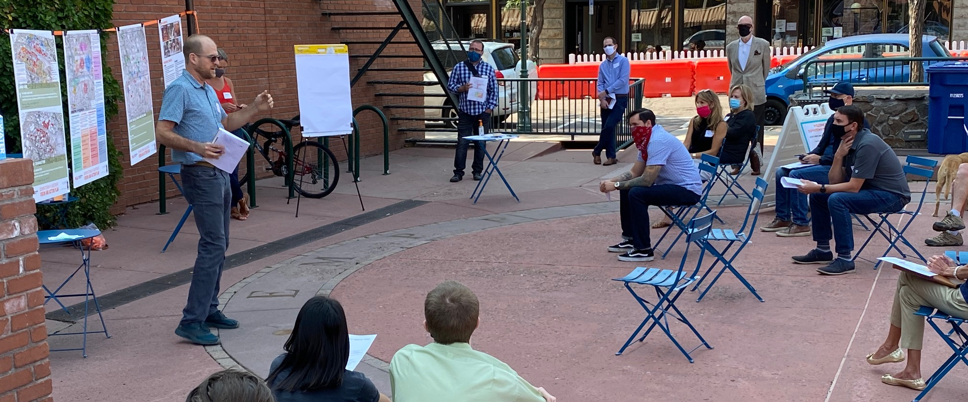
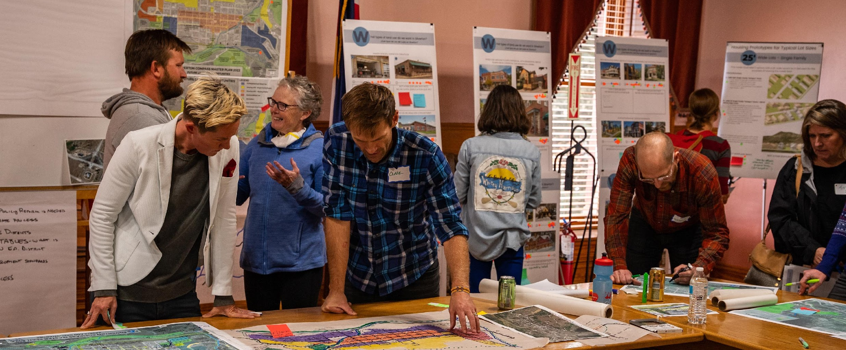
COMMUNITY ENGAGEMENT
Define the Scope of the planning process
Developing an understanding of the community landscape
Identifying core questions and trade-offs
Assessing community capacity
Design engagement strategies and identify resource needs
Decide how input will be used – be transparent
Notes:
Being clear about the scope of the housing strategy will make it easier to engage the community in a transparent and accountable way. The following steps should be outlined when developing the scope: identify the goals of the process, communicate the decisions the community can impact, be transparent about what is already decided based on the funding the development is receiving, and provide a timeline and decision-making structure that will dictate the process including how often you will meet with the community as well as internally.
Intentional efforts should be made to identify the families excluded from or underrepresented in decision-making processes in the past. In addition, potential residents should be informed about the development(s). In addition, you should identify other stakeholders that bring important perspectives, concerns, and expertise to the housing planning process such as: housing and non-housing practitioners, industry representatives, economic development, planning department, informal community leaders, and advocates.
The community engagement process is a chance to get the community’s help answering the tough questions local officials and staff must grapple in order to craft a housing strategy that is responsive to the needs of the community. While it might seem daunting to put controversial questions before the community, these questions will emerge regardless, and it is best to be frank about them from the start in order to ensure an inclusive process and secure community buy-in during implementation.
To ensure targeted and robust feedback from community members, you may also need to provide additional information related to the overall engagement process and the components of a housing strategy such as: the kind of information community members will need to comfortably and meaningfully engage in planning a housing strategy such as examples of housing types and a glossary of terms; determine how the materials and information will be delivered in a way that ensures accessibility for a diverse range of community groups; and, Identify who the point of contact is moving forward for people that have questions about the development.
There are a range of engagement strategies to consider depending on the scope of the planning process, the community landscape, the capacities of your local officials, your organization, the community, the questions that need to be answered, and the resources available. Many of these questions can be found in the correspondin workbook for this training on the DOLA/DOH website.
Lastly, To build community support, it is important to be clear with the participants about how the local government plans to use feedback from a task force, public meetings, online surveys, and any other engagement, and to follow through on those commitments. Your local officials and/or staff should be transparent about who will be involved in deciding what will be incorporated into the final strategy and how local officials will share and discuss with the public which community recommendations were used and which were not and why.

Slide 39
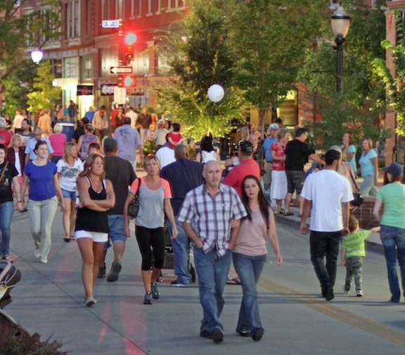
EXERCISE / DISCUSSION
  What particular groups of people who live in your community are missing from engagement or public discussions about housing (e.g. racial groups, people with disabilities, seniors, etc.)?
  What partnerships and consultant assistance may be required to complete a housing development?
Notes:
For this last exercise, please answer the following questions:​
What particular groups of people who live in your community are missing from engagement or public discussions about housing, for example, racial groups, people with disabilities, seniors, and others.​
What partnerships and consultant assistance may be required to complete a housing development in your community?

Slide 40
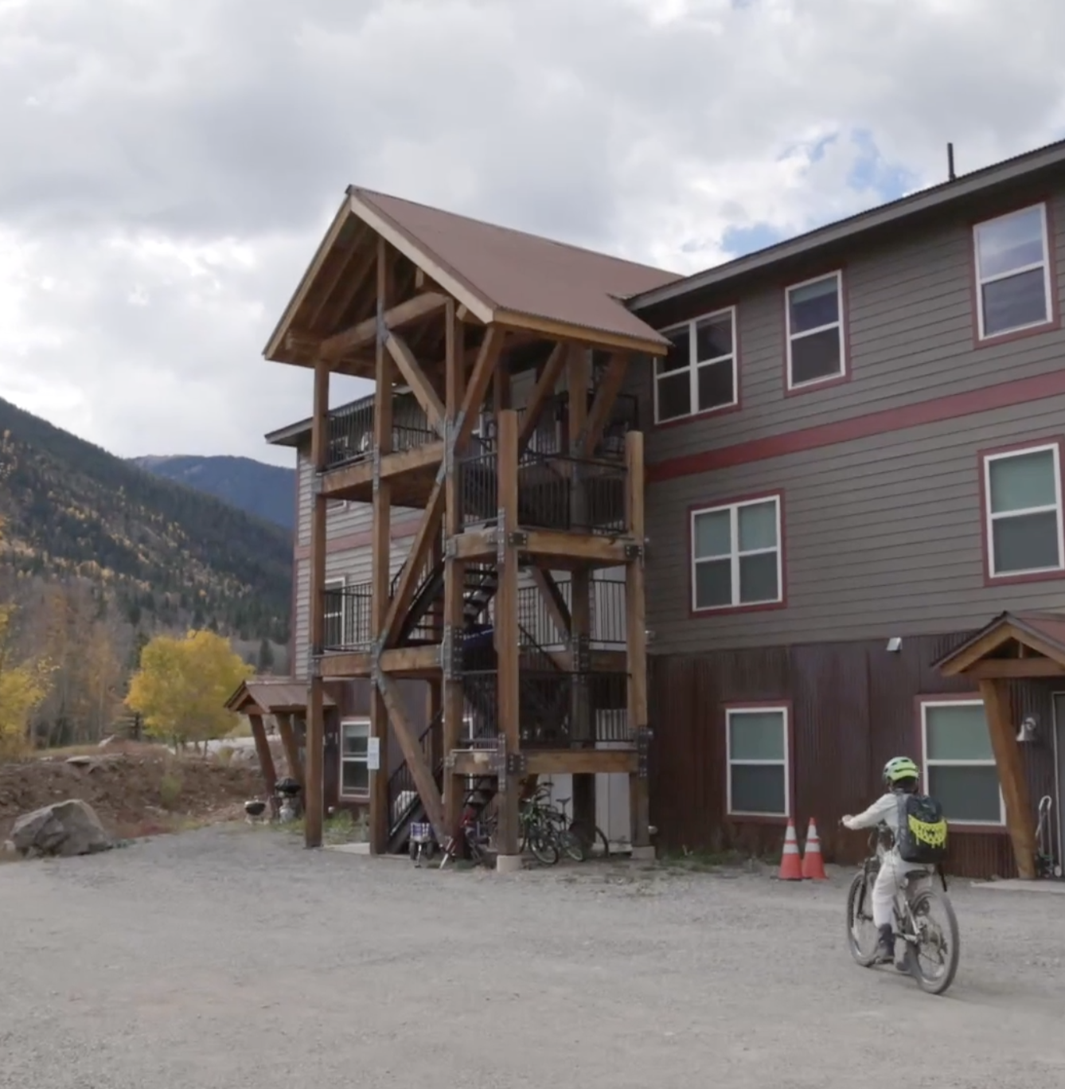
FURTHER LEARNING
    ADDITIONAL RESOURCES:
DOLA Division of Housing
Affordable Housing Toolkit for Local Officials
Stay up to date with training materials and next steps for Technical Assistance. Contact
  Andrew Atchley (719) 298-2903 andrew.atchley@state.co.us
      Natalie Wowk (720) 812-4137 natalie.wowk@state.co.us
      Sign up for DOH’s email blast here
Notes:
For more information and to view other learning sessions please look at the DOLA Division of Housing website resources listed on your screen or reach out to Andrew Atchley or Natalie Wowk as listed on the screen. ​

Slide 41
THANK YOU!
Notes:
Thank you very much for your participation in this webinar. I look forward to seeing soon for an in-person training!

